Slide 1
2012 BioXGEM-RBC kinase profiling
(50 natural products against 32 protein kinases)

Slide 2
Aim
Explore co-evolution between mammals and plants and identify natural products as kinase inhibitors
  Do flavonoids mimic adenine-based elements in mammals?
Enhance cooperation
  王應然

Slide 3
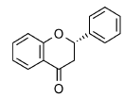
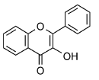
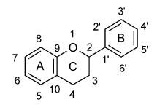
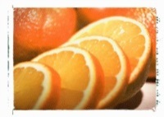
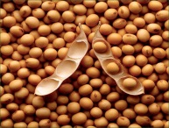
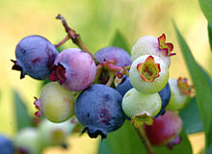
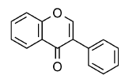

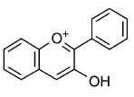
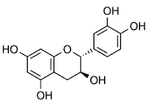
Do flavonoids mimic adenine-based elements in mammals?
Plants
Co-evolution?
Mammals
Flavonoids
NNT
ATP
Essential elements
Kinase
Flavonol
Flavanone
NAPDH
GTP
PKMT
SAM
G-proteins
Isoflavones
Anthocyanidins
Adenosine
Topoisomerase
Catechin
Energy
Inflammation
Central dogma
Epigenetic
Oxidation-reduction
Anti-fungal…
Anti-oxidative stress…
Defence for life
Isoflavones
Adenine Core
ATP
NAPDH
Flavonol
Anthocyanidins
Adenosine
SAM
Catechin

Slide 4
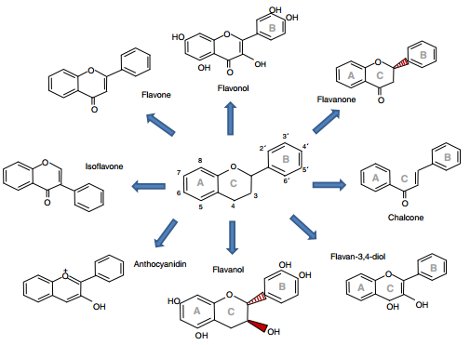
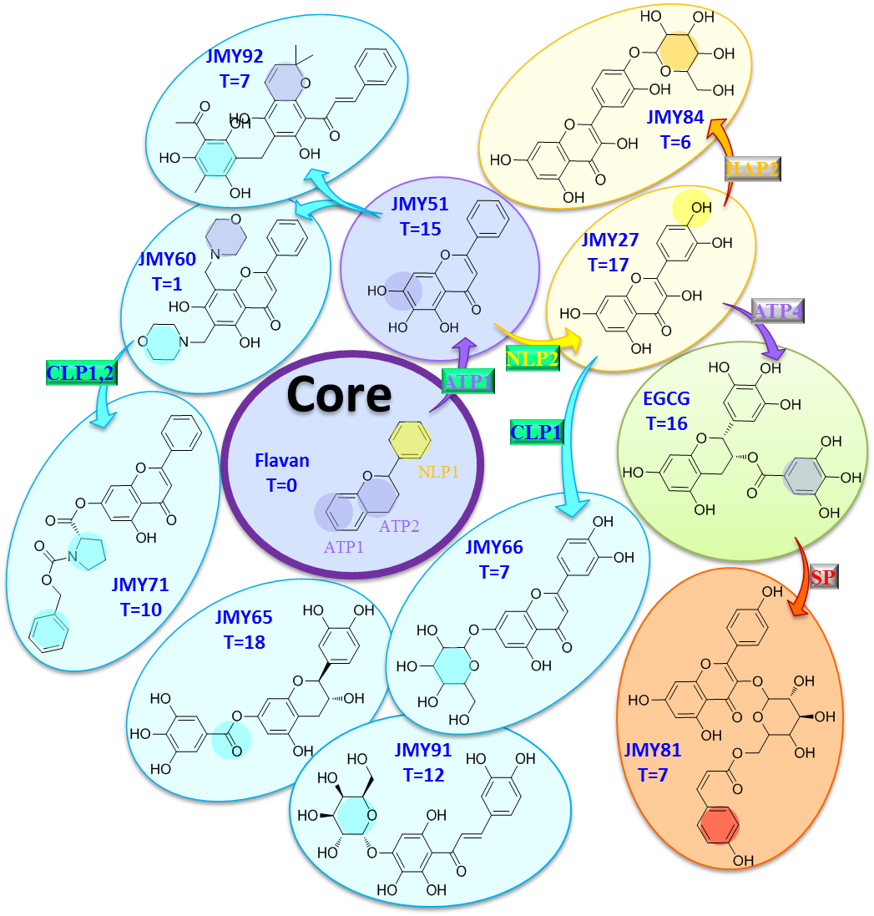
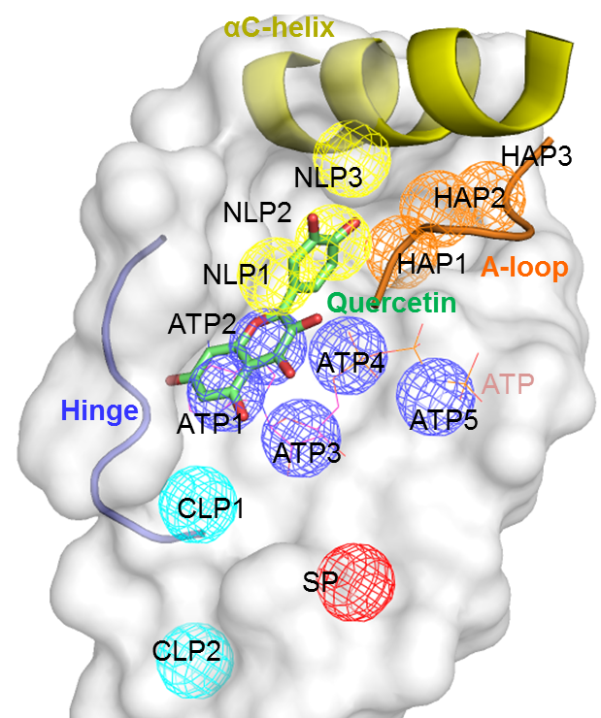
The relationships between flavonoids and kinases
Flavonoids
Flavonoid-kinase tree?
KIDFamMap
Chiu, Y. Y., Lin, C. T., Huang, J. W., Hsu, K. C., Tseng, J. H., You, S. R., and Yang, J.M.* (2013) Nucleic Acids Res 41.
Nucleic Acids Research, 2013

Slide 5
Design
Explore co-evolution between mammals and plants and identify natural products as kinase inhibitors
  Compare with 2011 Merck-Millipore profiling (JMY27-JMY30)
  Flavonoids & compounds mimic flavonoids (JMY51-JMY92)
Enhance cooperation
  王應然 (JMY93-JMY96)

Slide 6
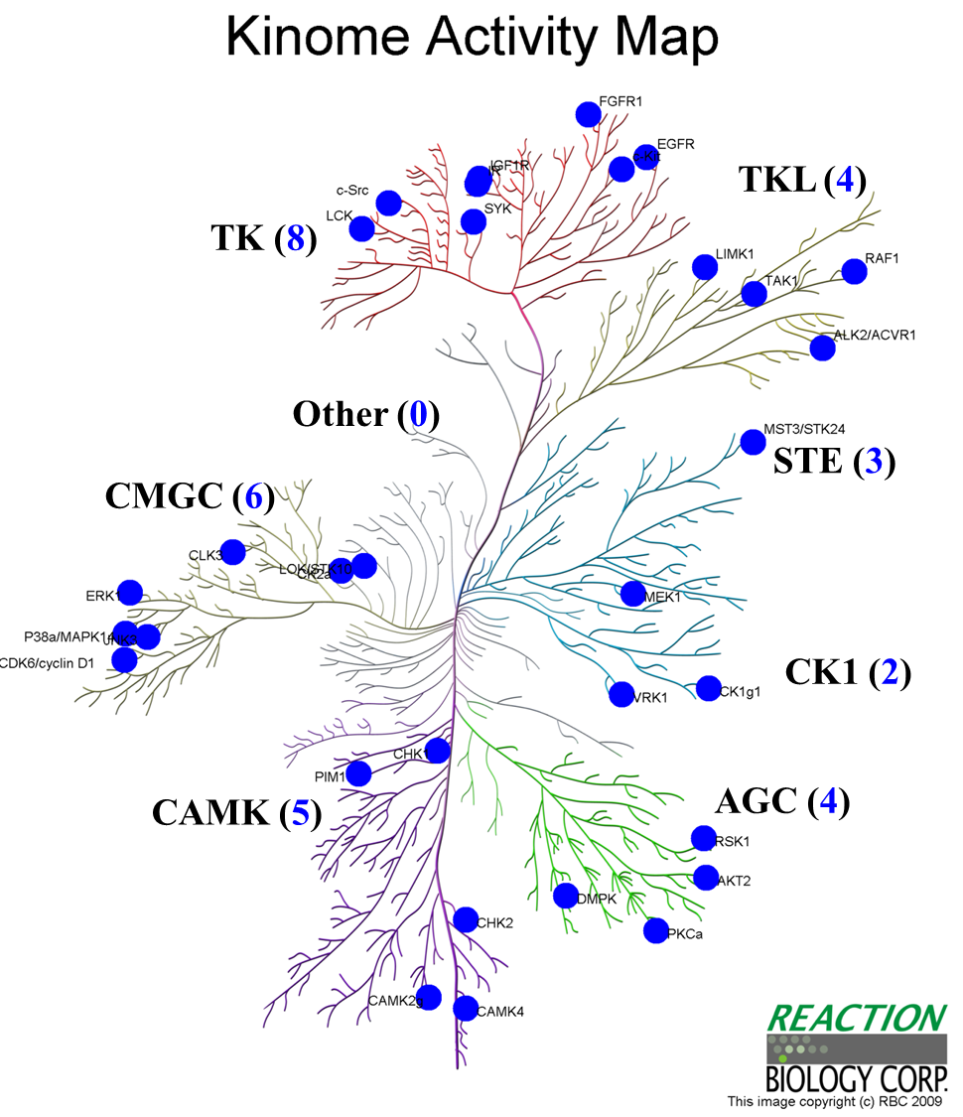
Kinase profiling
Service vendor: Reaction Biology Corporation (RBC)
Tested kinase: 32 kinases
  AGC (4), CAMK (5), CK1 (2), CMGC (6), Other (0), STE (3), TK (8), TKL (4)
Tested compound: 50 compounds
  Normalization/reference (4)
  Flavonoids & compounds mimic flavonoids (42)
  Cooperation (4)
Tested condition: 10 μM, duplicate

Slide 7
20121015 RBC 50 natural products against 32 protein kinases profiling
JMY27 | T=17 | S=53% | JMY28 | T=0 | S=0% | JMY29 | T=16 | S=50% | JMY30 | T=11 | S=34%
Quercetin (QUE) |  |  | Catechin (KXN) |  |  | EGCG (KDH) |  |  | Rosmarinic acid
JMY51 | T=15 | S=47% | JMY52 | T=4 | S=13% | JMY53 | T=0 | S=0% | JMY54 | T=0 | S=0%
ZINC03871633 |  |  | ZINC18825330 (GEN) |  |  | ZINC20761617 |  |  | ZINC20392112
JMY55 | T=1 | S=3% | JMY56 | T=0 | S=0% | JMY57 | T=0 | S=0% | JMY58 | T=0 | S=0%
ZINC37858693 |  |  | ZINC08764602 |  |  | ZINC34285235 (L5G) |  |  | ZINC04098511

Slide 8
20121015 RBC 50 natural products against 32 protein kinases profiling
JMY59 | T=0 | S=0% | JMY60 | T=1 | S=3% | JMY61 | T=0 | S=0% | JMY62 | T=15 | S=47%
ZINC01531697 |  |  | ZINC20113170 |  |  | ZINC08836734 |  |  | ZINC03952380
JMY63 | T=6 | S=19% | JMY64 | T=2 | S=6% | JMY65 | T=18 | S=56% | JMY66 | T=7 | S=22%
ZINC03870533 (PD1) |  |  | ZINC00038933 (BHF) |  |  | ZINC14642868 |  |  | ZINC04096258
JMY67 | T=0 | S=0% | JMY68 | T=0 | S=0% | JMY69 | T=0 | S=0% | JMY70 | T=0 | S=0%
ZINC09410773 |  |  | ZINC01447956 |  |  | ZINC18115831 |  |  | ZINC20762183

Slide 9
20121015 RBC 50 natural products against 32 protein kinases profiling
JMY71 | T=10 | S=31% | JMY72 | T=0 | S=0% | JMY73 | T=2 | S=6% | JMY74 | T=8 | S=25%
ZINC12657623 |  |  | ZINC12296962 |  |  | ZINC12872097 |  |  | ZINC06112330
JMY75 | T=0 | S=0% | JMY76 | T=0 | S=0% | JMY77 | T=0 | S=0% | JMY78 | T=0 | S=0%
ZINC9547902 |  |  | ZINC38139524 |  |  | ZINC17170902 |  |  | ZINC12390526
JMY79 | T=20 | S=63% | JMY80 | T=0 | S=0% | JMY81 | T=7 | S=22% | JMY82 | T=3 | S=9%
ZINC01486219 |  |  | ZINC04349478 |  |  | ZINC49888963 |  |  | ZINC01546258

Slide 10
20121015 RBC 50 natural products against 32 protein kinases profiling
JMY83 | T=0 | S=0% | JMY84 | T=6 | S=19% | JMY85 | T=0 | S=0% | JMY86 | T=0 | S=0%
ZINC08647924 |  |  | ZINC13424741 |  |  | ZINC20112214 |  |  | ZINC01062193
JMY87 | T=0 | S=0% | JMY88 | T=2 | S=6% | JMY89 | T=0 | S=0% | JMY90 | T=9 | S=28%
ZINC01898781 |  |  | ZINC01065219 |  |  | ZINC04649214 |  |  | ZINC12428433
JMY91 | T=12 | S=38% | JMY92 | T=7 | S=22% | JMY93 | T=0 | S=0% | JMY94 | T=3 | S=9%
ZINC13424695 |  |  | ZINC03874886 |  |  | Magnolol |  |  | Rosmanol

Slide 11
20121015 RBC 50 natural products against 32 protein kinases profiling
JMY95 | T=0 | S=0% | JMY96 | T=1 | S=3% |  | T= | S=% |  | T= | S=%
Nobiletin |  |  | 6-shogaol
 | T= | S=% |  | T= | S=% |  | T= | S=% |  | T= | S=%
 | T= | S=% |  | T= | S=% |  | T= | S=% |  | T= | S=%

Slide 12
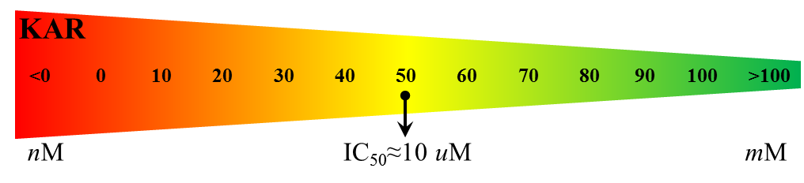
Results/analysis summary
50 natural products against 32 protein kinases
→ 25 natural products as kinase inhibitors
最具選擇性之flavonoid
JMY55: PIM1 only (KAR=11)
JMY60: LCK only (KAR=10)
JMY96 (from 王應然): CAMK4 only (KAR=46)
最廣效型之flavonoid
JMY79 (selectivity = 63%)
Target number | Inhibitor number
0 | 25
1~5 | 9
6~10 | 8
11~15 | 4
16~20 | 4
kinase activity remaining (KAR) Expressed the average substrate phosphorylation results as a percentage of solvent control reactions (referred to as remaining kinase activity)¹
  KAR ≈ 50 means IC₅₀ ≈ 10 μM

Slide 13
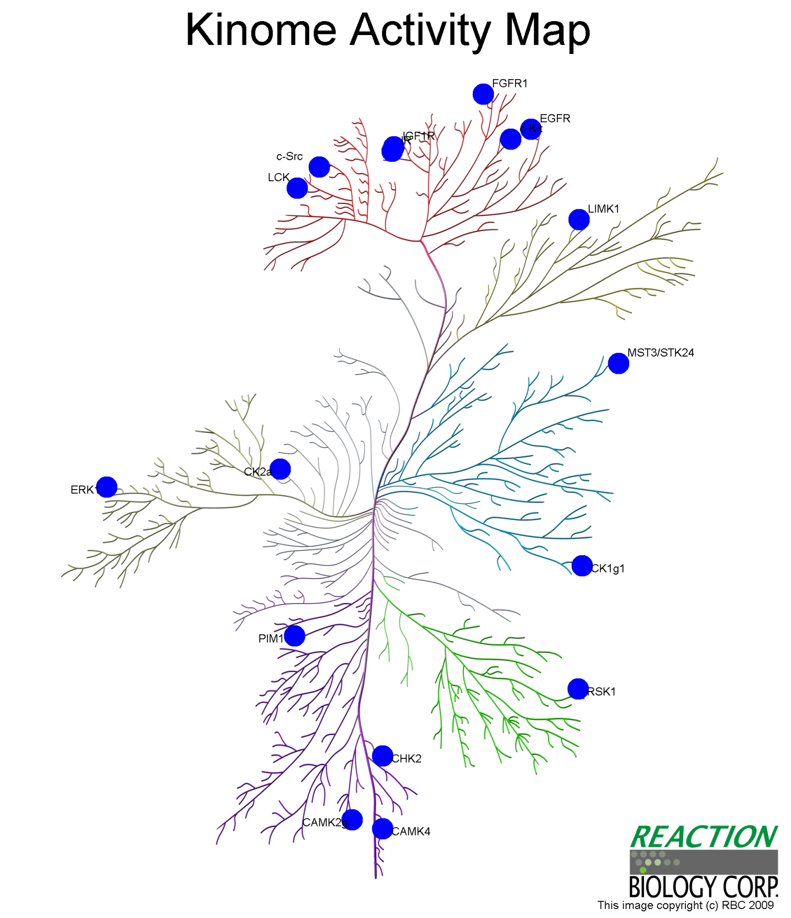
JMY27
FGFR1
(KAR = 1.5%)
TKL
Compound 2D
Compound Name | Quercetin
Target number (IC₅₀<10 uM) | 17 (53%)
Best target | CSNK2A1
KAR | -0.2%
TK
Other
STE
CMGC
CSNK2A1
(KAR = -0.2%)
CK1
CAMK
AGC
CAMK2G
(KAR = 3.2%)

Slide 14

JMY29
INSR
(KAR = 4.6%)
FGFR1
(KAR = 7%)
SRC
(KAR = 0.8%)
EGFR
(KAR = 46%)
IGF1R
(KAR = 5%)
INSR
(KAR = 5%)
KIT
(KAR = 12%)
TKL
Compound 2D
Compound Name | EGCG
Target number (IC₅₀<10 uM) | 16 (50%)
Best target | CSNK2A1
KAR | -0.1%
TK
LCK
(KAR = 33%)
LIMK1
(KAR = 17%)
STK24
(KAR = 46%)
Other
STE
CMGC
CSNK2A1
(KAR = -0.1%)
MAPK3
(KAR = 27%)
CK1
CSNK1G1
(KAR = 5%)
PIM1
(KAR = 29%)
CAMK
AGC
RPS6KA1
(KAR = 11%)
CAMK2G
(KAR = 20%)
CAMK4
(KAR = 12%)

Slide 15
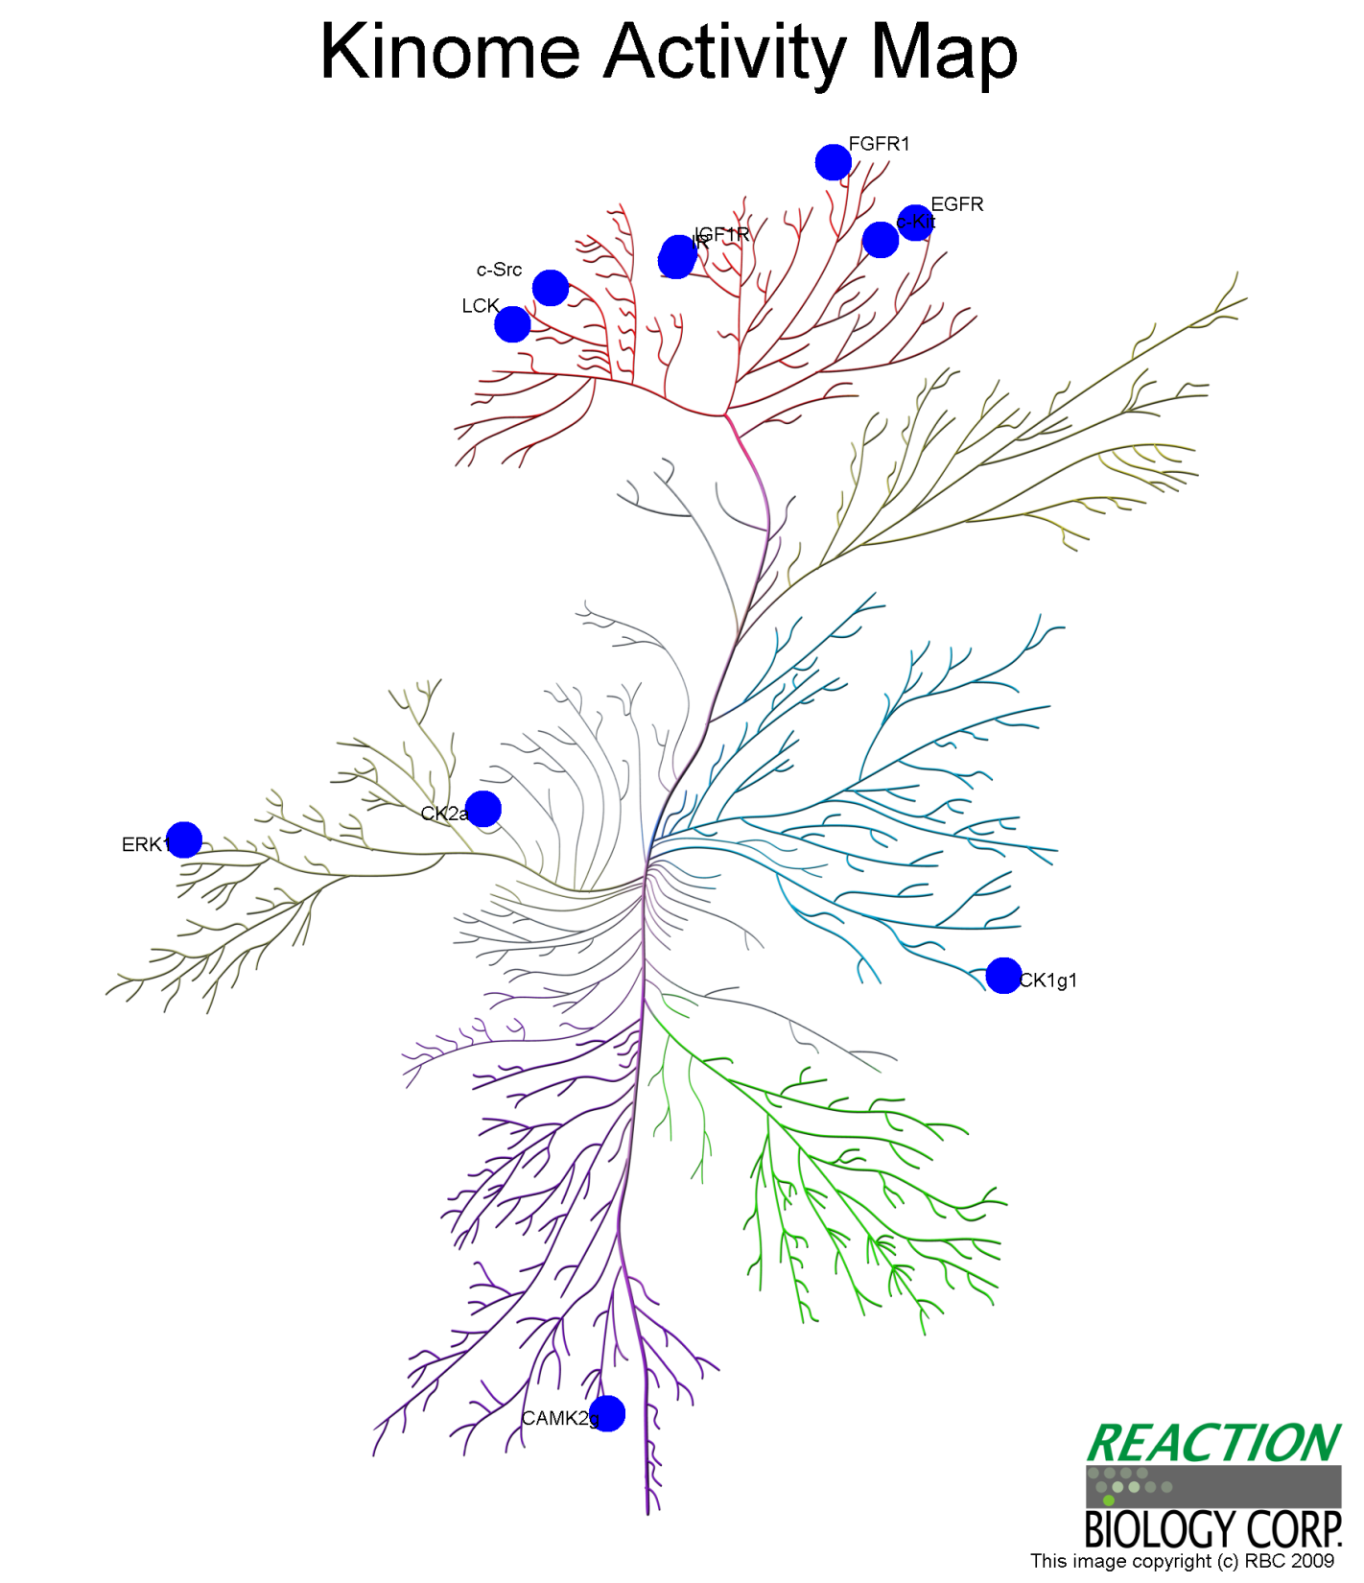
JMY30
FGFR1
(KAR = 14.4%)
TKL
Compound 2D
Compound Name | Rosmarinic acid
Target number (IC₅₀<10 uM) | 11 (34%)
Best target | CSNK2A1
KAR | -0.2%
TK
Other
STE
CMGC
CSNK2A1
(KAR = -0.2%)
CK1
CSNK1G1
(KAR = 7.3%)
CAMK
AGC

Slide 16
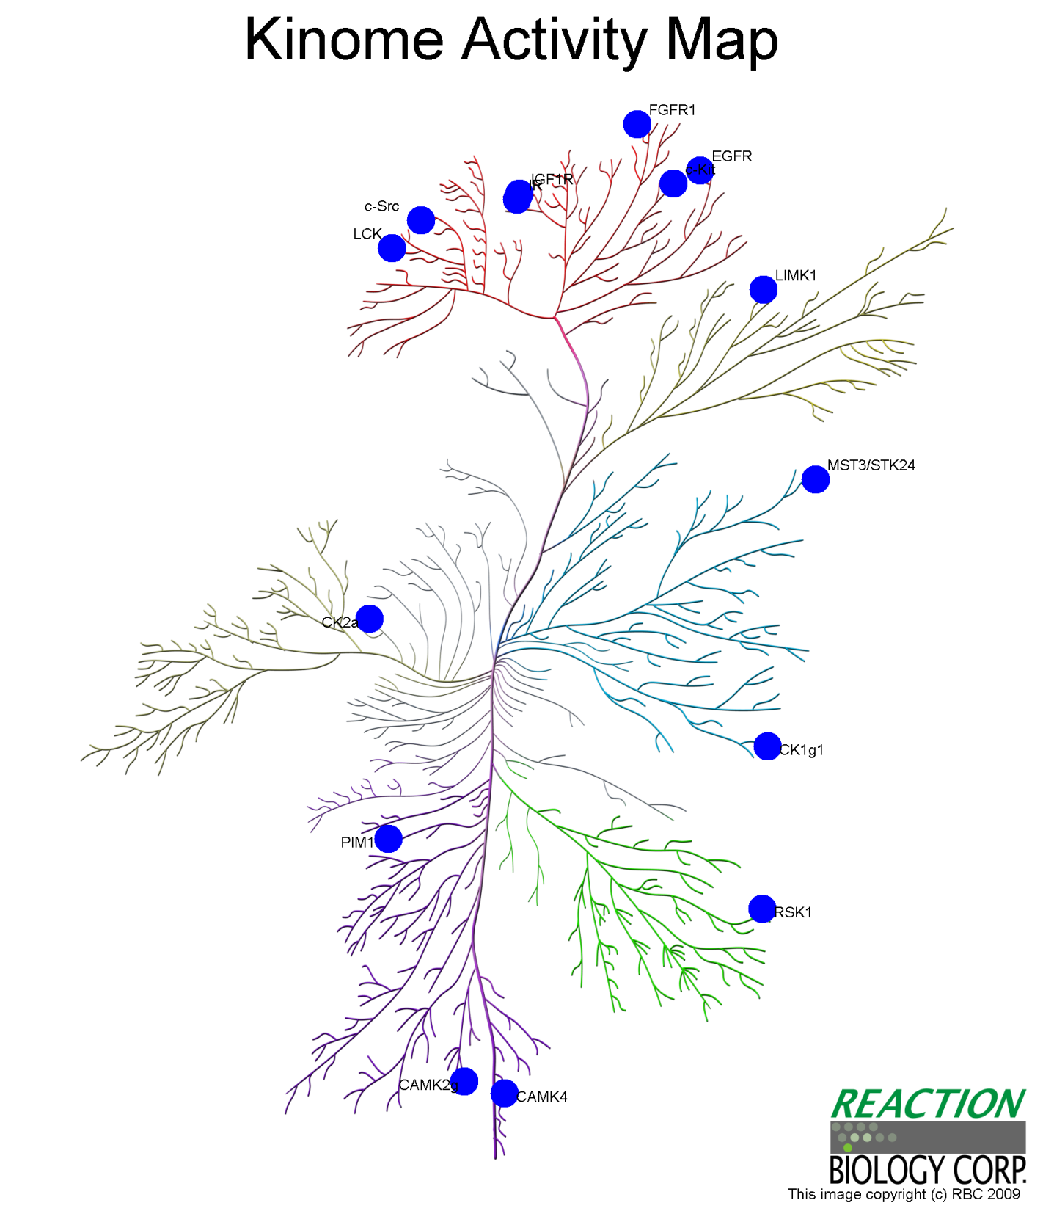
JMY51
INSR
(KAR = 11.9%)
IGF1R
(KAR = 6.7%)
FGFR1
(KAR = 14.4%)
TKL
Compound 2D
Compound Name | ZINC03871633
Target number (IC₅₀<10 uM) | 15 (47%)
Best target | IGF1R
KAR | 6.7%
TK
Other
STE
CMGC
CK1
CAMK
AGC

Slide 17
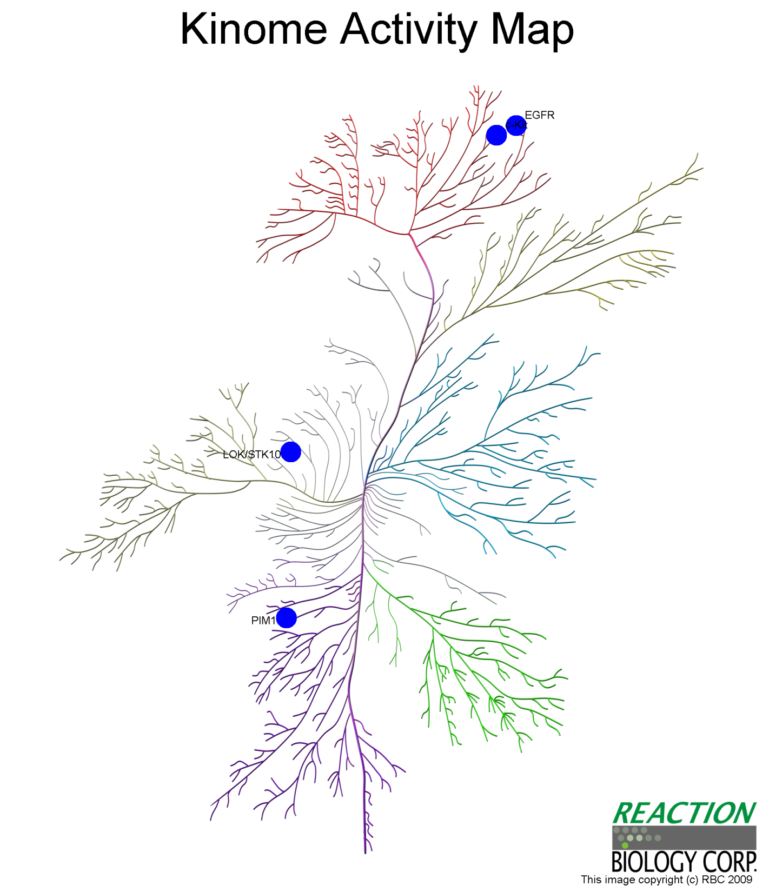
JMY52
KIT
(KAR = 39.8%)
EGFR
(KAR = 28.8%)
TKL
Compound 2D
Compound Name | ZINC18825330
Target number (IC₅₀<10 uM) | 4 (13%)
Best target | PIM1
KAR | 21.7%
TK
Other
STE
CMGC
STK10
(KAR = 38.4%)
CK1
PIM1
(KAR = 21.7%)
CAMK
AGC

Slide 18
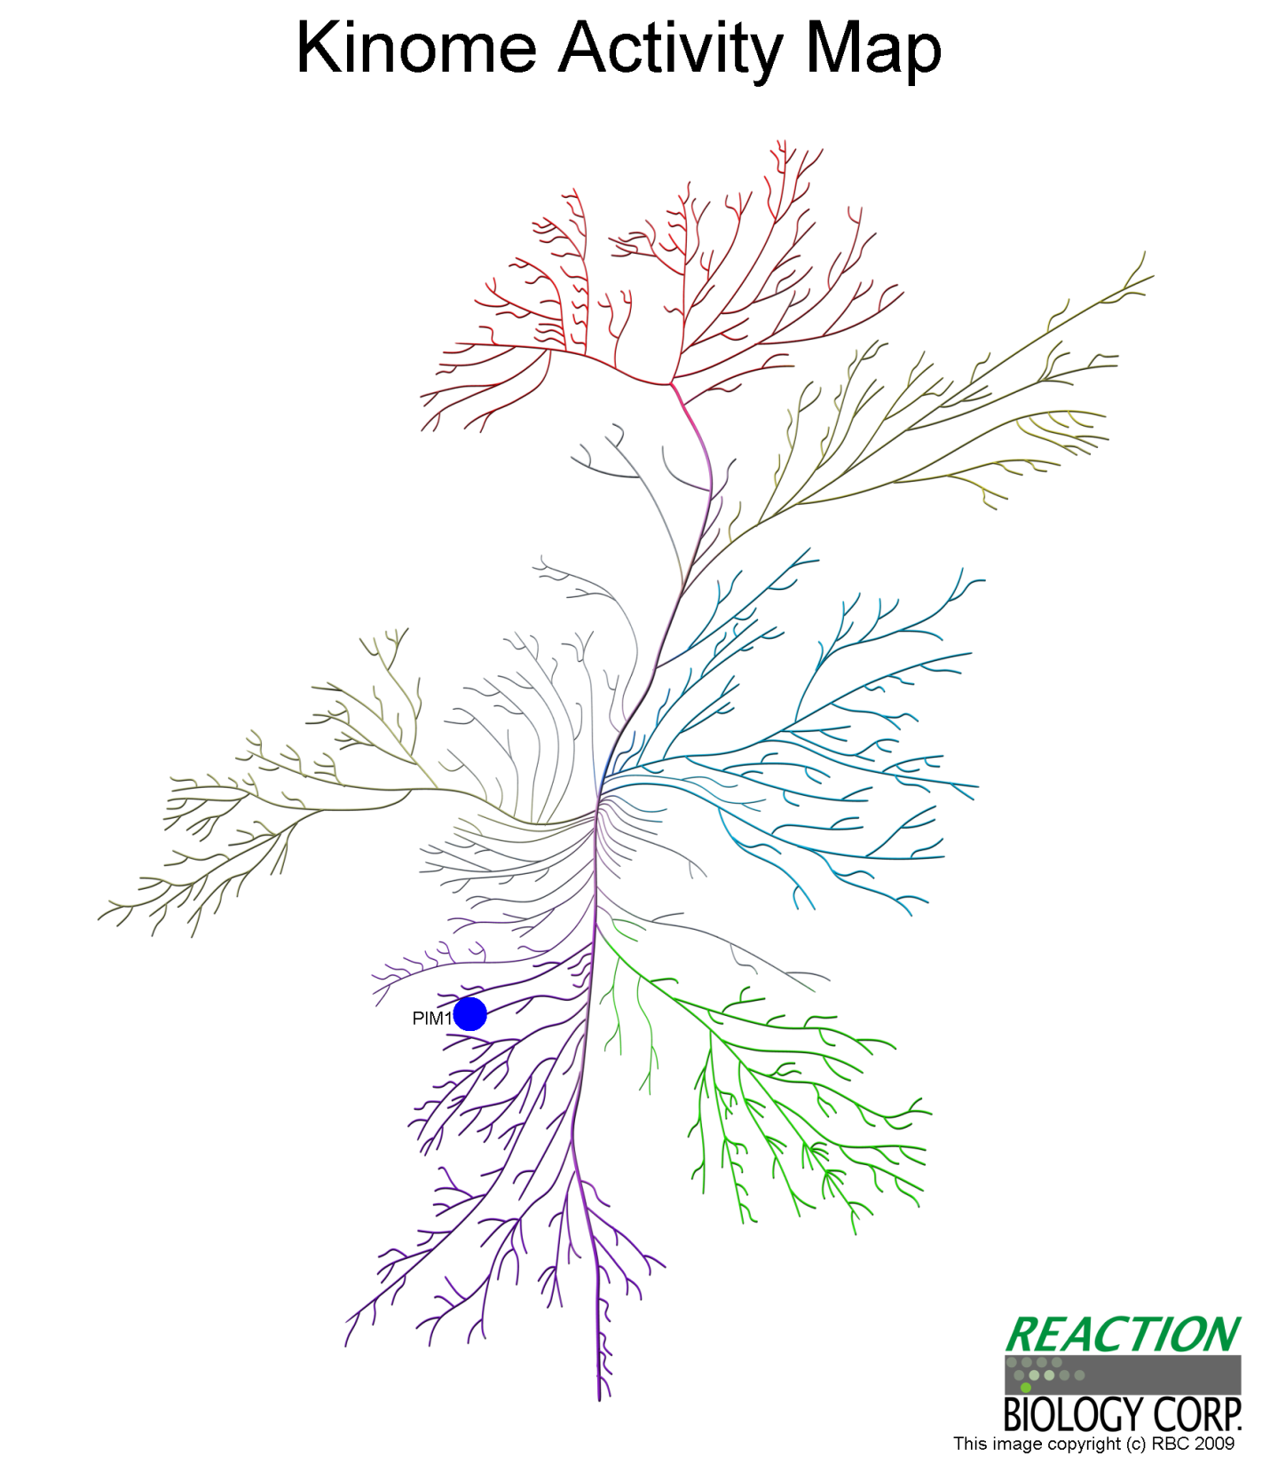
JMY55
TKL
Compound 2D
Compound Name | ZINC37858693
Target number (IC₅₀<10 uM) | 1 (3%)
Best target | PIM1
KAR | 10.7%
TK
Other
STE
CMGC
CK1
PIM1
(KAR = 10.7%)
CAMK
AGC

Slide 19
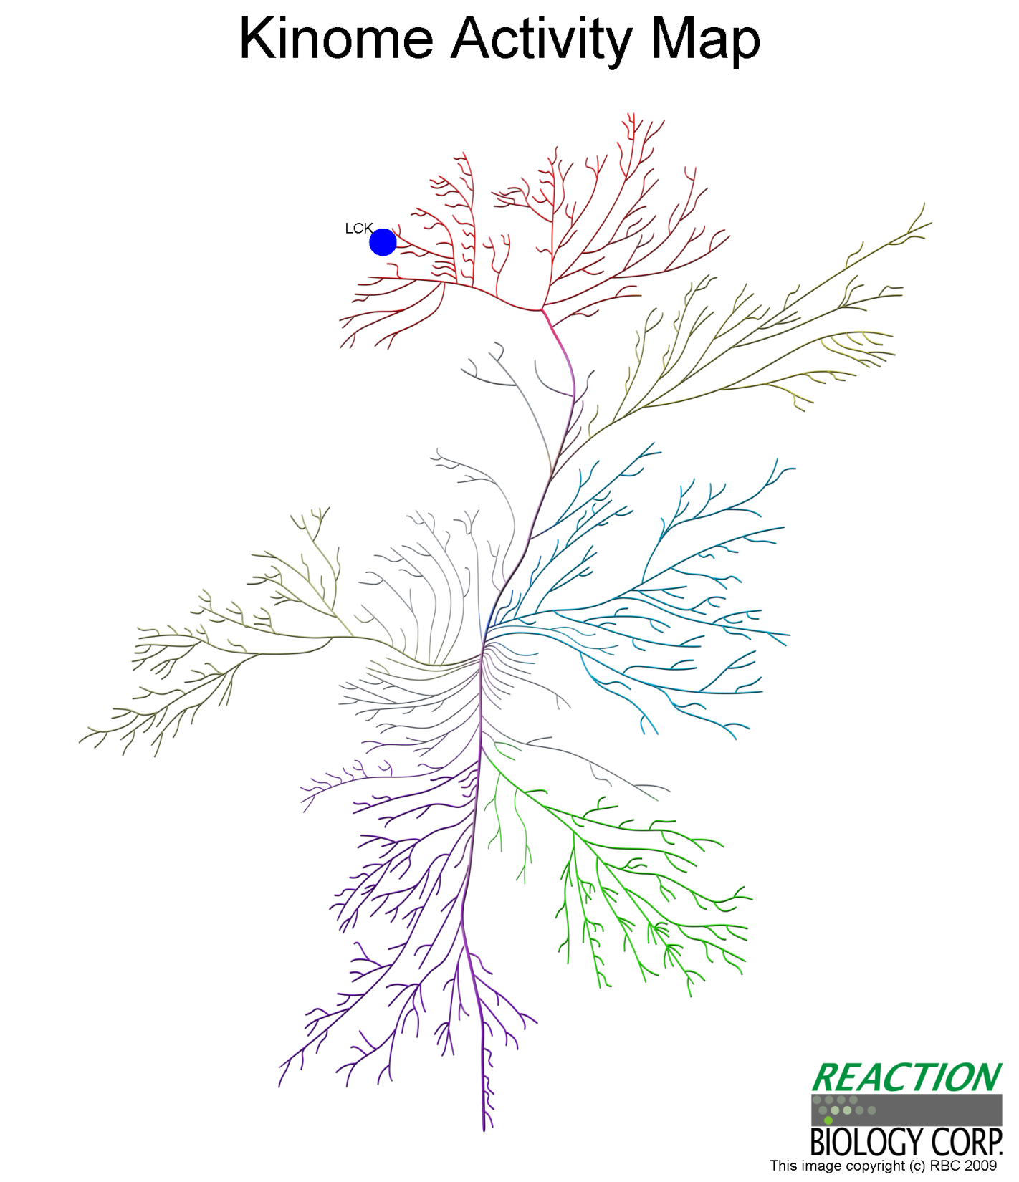
JMY60
LCK
(KAR = 10%)
TKL
Compound 2D
Compound Name | ZINC20113170
Target number (IC₅₀<10 uM) | 1 (3%)
Best target | LCK
KAR | 10%
TK
Other
STE
CMGC
CK1
CAMK
AGC

Slide 20
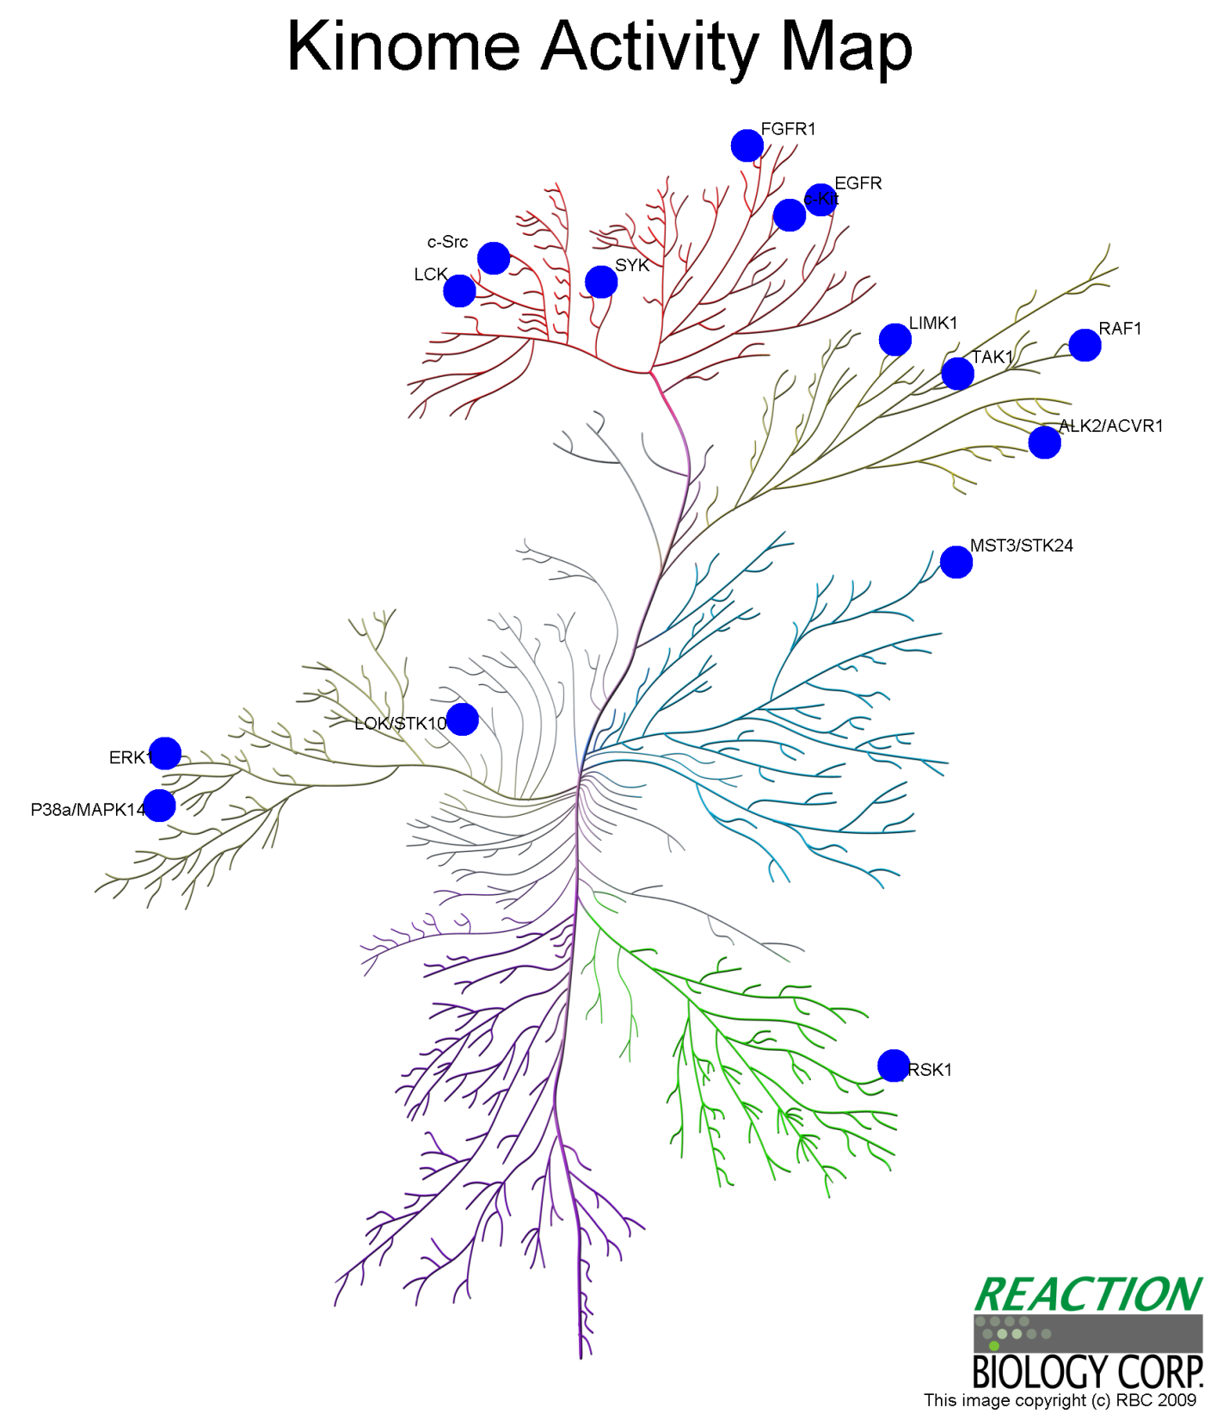
JMY62
KIT
(KAR = 0.7%)
SRC
(KAR = -0.1%)
RAF1
(KAR = 0.9%)
TKL
Compound 2D
Compound Name | ZINC03952380
Target number (IC₅₀<10 uM) | 15 (47%)
Best target | SRC
KAR | -0.1%
TK
Other
STE
CMGC
CK1
CAMK
AGC

Slide 21
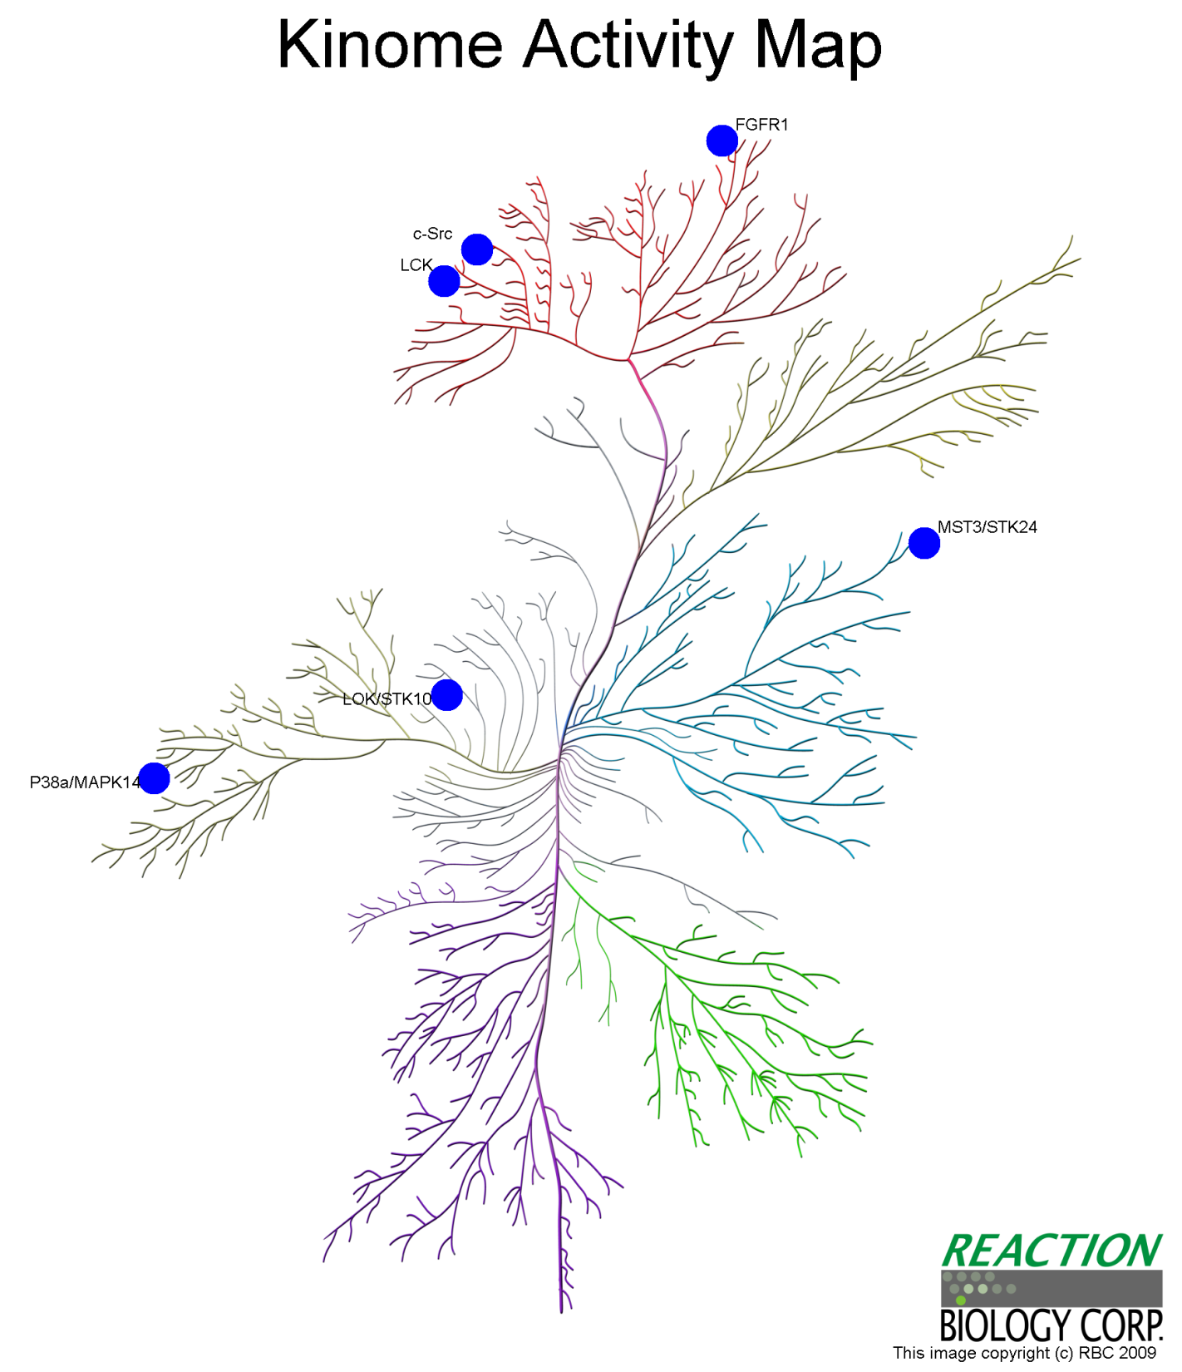
JMY63
SRC
(KAR = 34%)
FGFR1
(KAR = 1.8%)
LCK
(KAR = 12.3%)
TKL
Compound 2D
Compound Name | ZINC03870533
Target number (IC₅₀<10 uM) | 6 (19%)
Best target | FGFR1
KAR | 1.8%
TK
Other
STE
CMGC
STK10
(KAR = 28%)
STK24
(KAR = 11.7%)
MAPK14
(KAR = 37%)
CK1
CAMK
AGC

Slide 22

JMY64
TKL
Compound 2D
Compound Name | ZINC00038933
Target number (IC₅₀<10 uM) | 2 (6%)
Best target | PIM1
KAR | 5.4%
TK
Other
STE
CMGC
CK1
PIM1
(KAR = 5.4%)
CAMK
AGC
CAMK2G
(KAR = 38.7%)

Slide 23
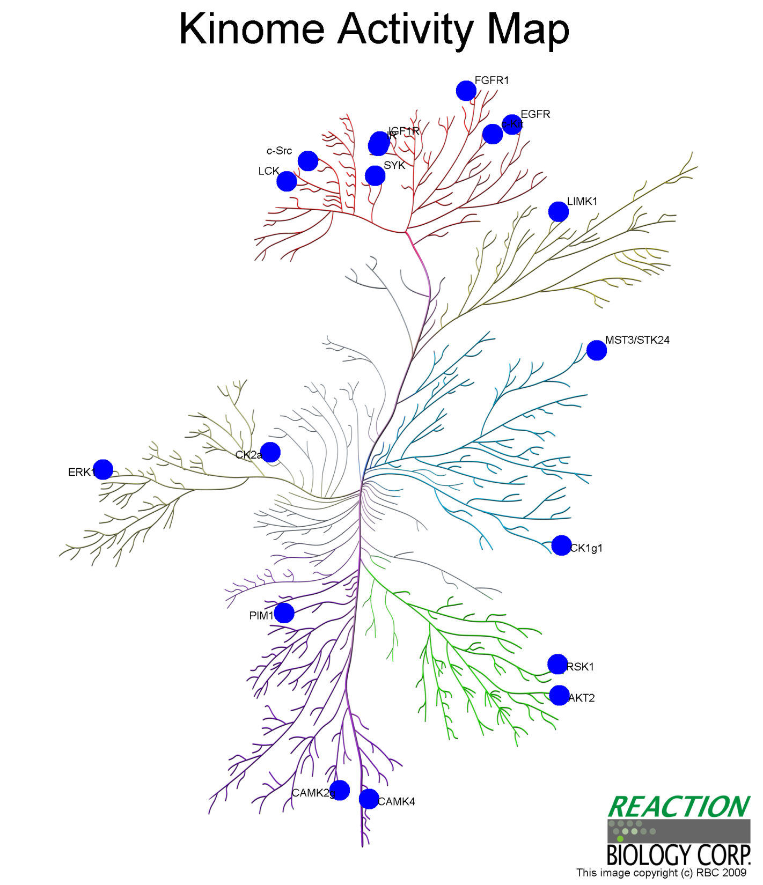
JMY65
IGF1R
(KAR = -0.5%)
SRC
(KAR = 0.3%)
TKL
Compound 2D
Compound Name | ZINC14642868
Target number (IC₅₀<10 uM) | 18 (56%)
Best target | IGF1R
KAR | -0.5%
TK
Other
CSNK2A1
(KAR = -0.3%)
STE
CMGC
CK1
CAMK
AGC

Slide 24
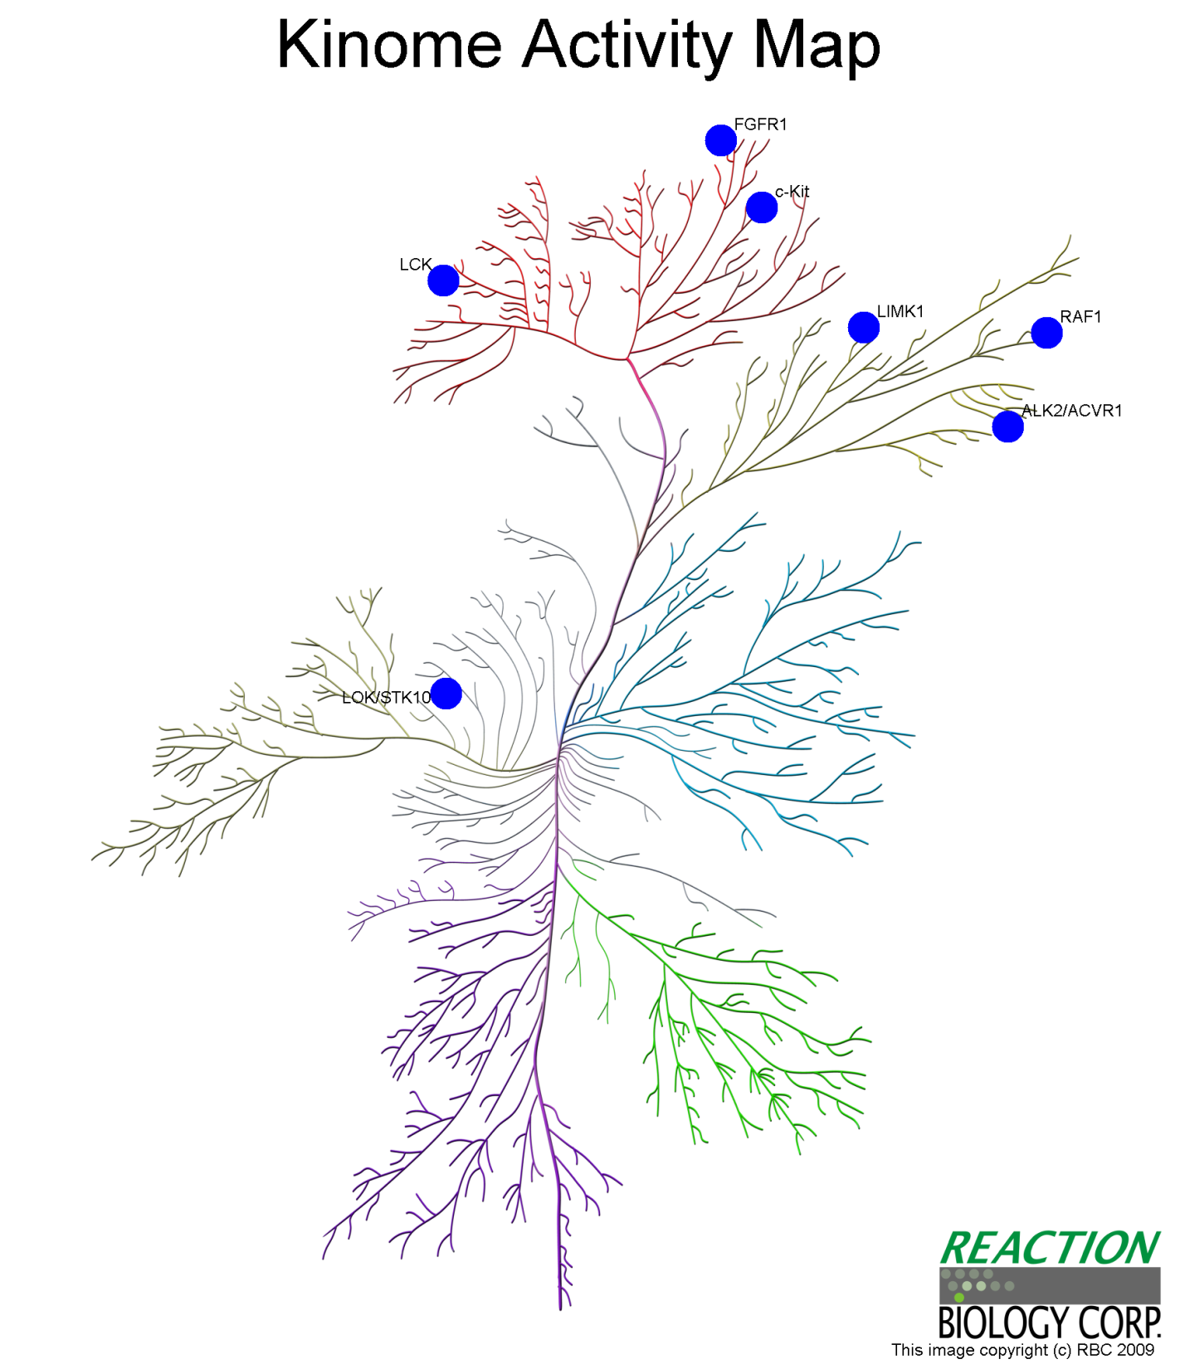
JMY66
KIT
(KAR = 29.9%)
LIMK1
(KAR = 33.9%)
TKL
Compound 2D
Compound Name | ZINC04096258
Target number (IC₅₀<10 uM) | 7 (22%)
Best target | KIT
KAR | 30%
TK
ACVR1
(KAR = 31.1%)
Other
STE
CMGC
CK1
CAMK
AGC

Slide 25
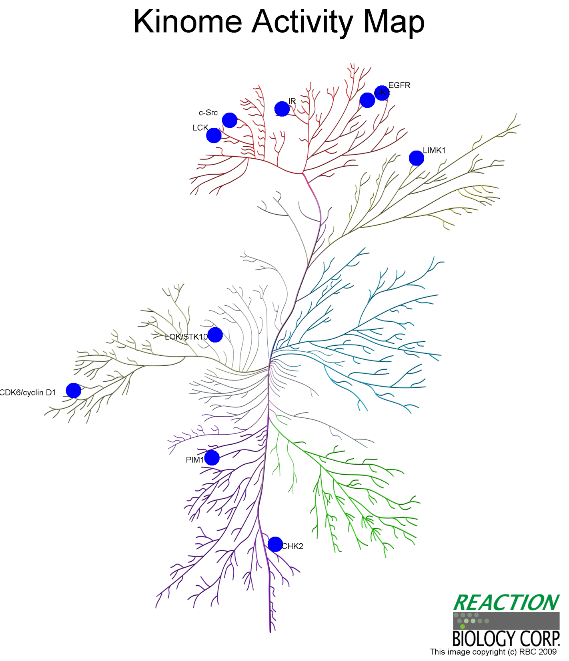
JMY71
SRC
(KAR = 10.1%)
LIMK1
(KAR = 7.3%)
LCK
(KAR = 3.7%)
TKL
Compound 2D
Compound Name | ZINC12657623
Target number (IC₅₀<10 uM) | 10 (31%)
Best target | LCK
KAR | 3.7%
TK
Other
STE
CMGC
CK1
CAMK
AGC

Slide 26
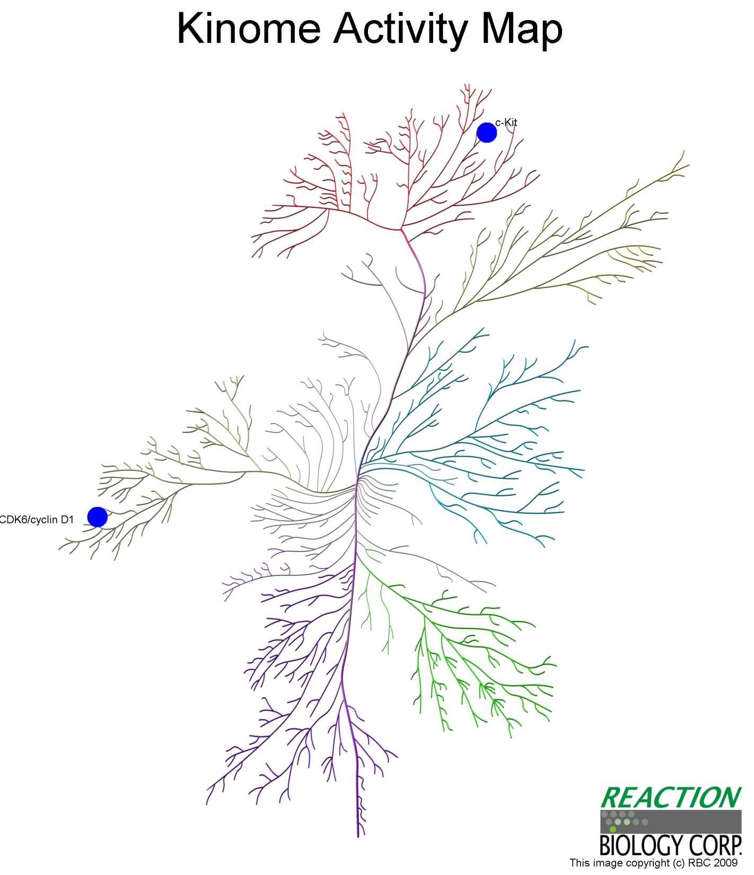
JMY73
KIT
(KAR = 44.5%)
TKL
Compound 2D
Compound Name | ZINC12872097
Target number (IC₅₀<10 uM) | 2 (6%)
Best target | KIT
KAR | 44.5%
TK
Other
STE
CMGC
CK1
CDK6
(KAR = 44.7%)
CAMK
AGC

Slide 27
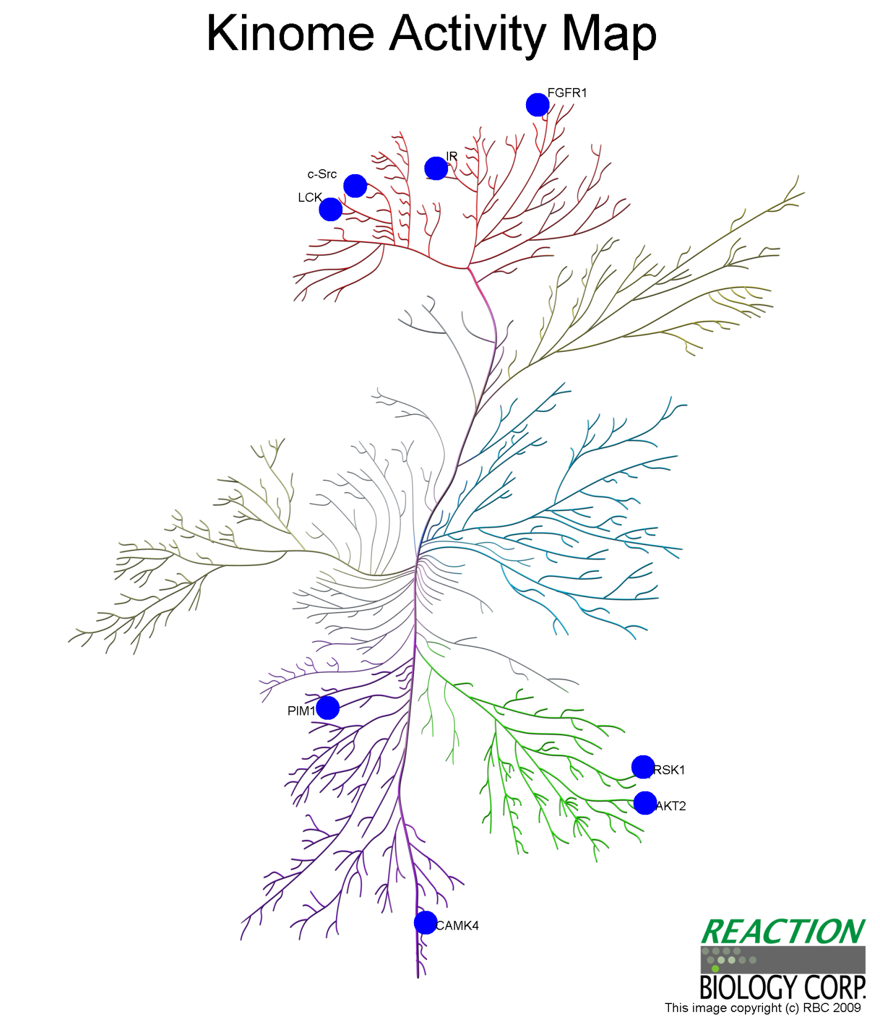
JMY74
FGFR1
(KAR = 22.2%)
INSR
(KAR = 30%)
TKL
Compound 2D
Compound Name | ZINC06112330
Target number (IC₅₀<10 uM) | 8 (25%)
Best target | FGFR1
KAR | 22.2%
TK
Other
STE
CMGC
RPS6KA1
(KAR = 32.8%)
CK1
CAMK
AGC

Slide 28
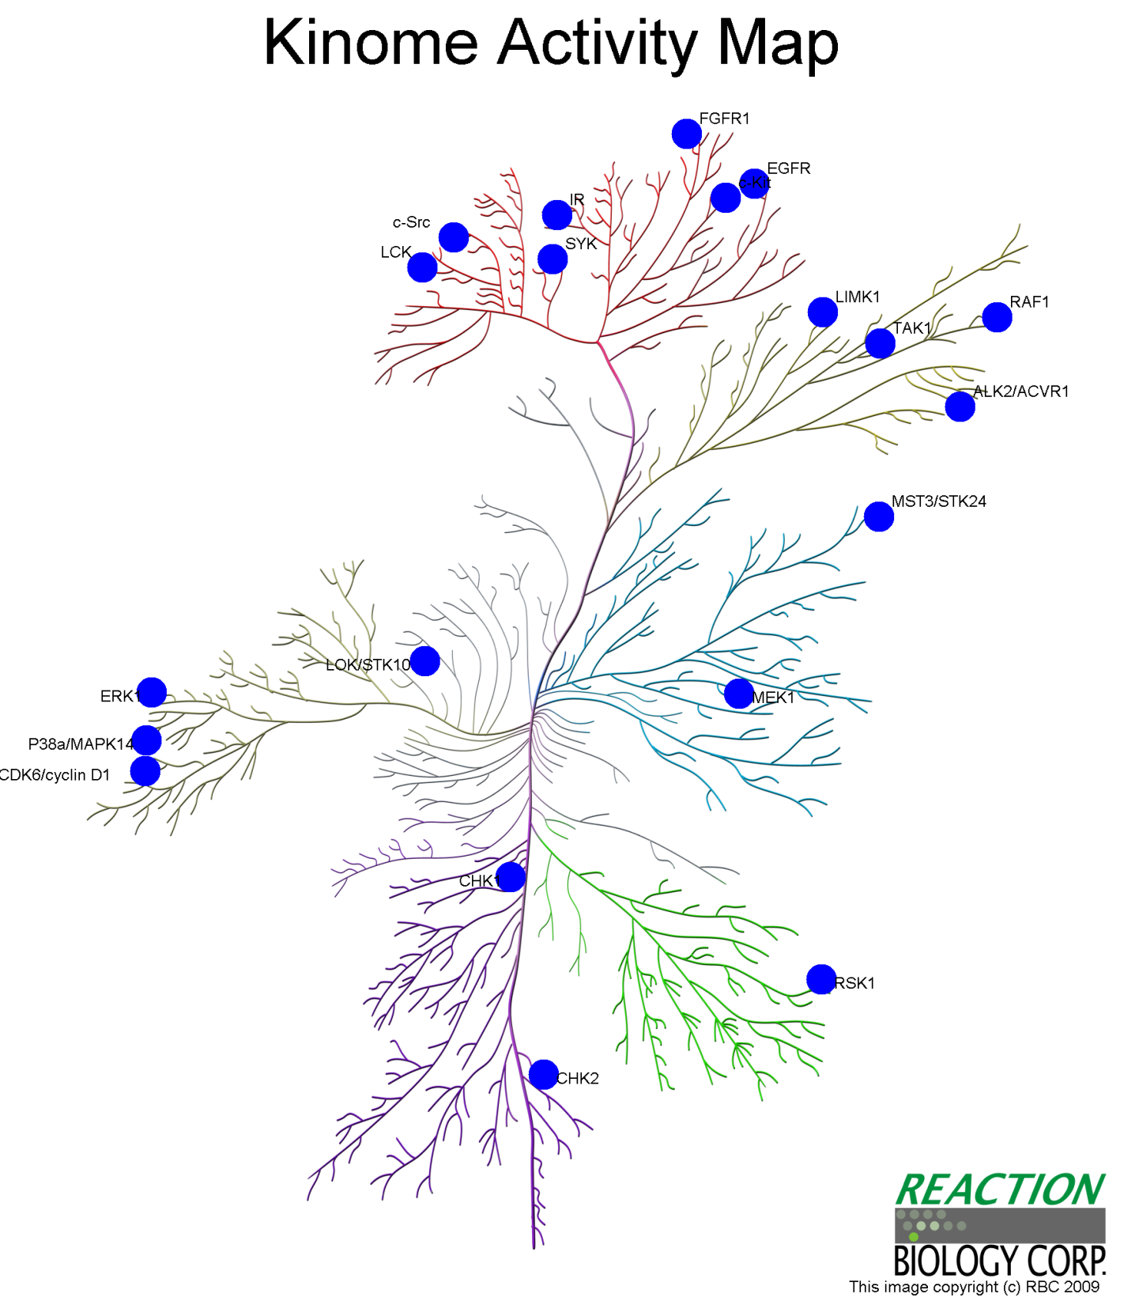
JMY79
SRC
(KAR = 0.6%)
RAF1
(KAR = 0.4%)
LIMK1
(KAR = 0.7%)
Compound 2D
Compound Name | ZINC01486219
Target number (IC₅₀<10 uM) | 20 (63%)
Best target | RAF1
KAR | 0.4%
TK
TKL
Other
STE
CMGC
CK1
CAMK
AGC

Slide 29
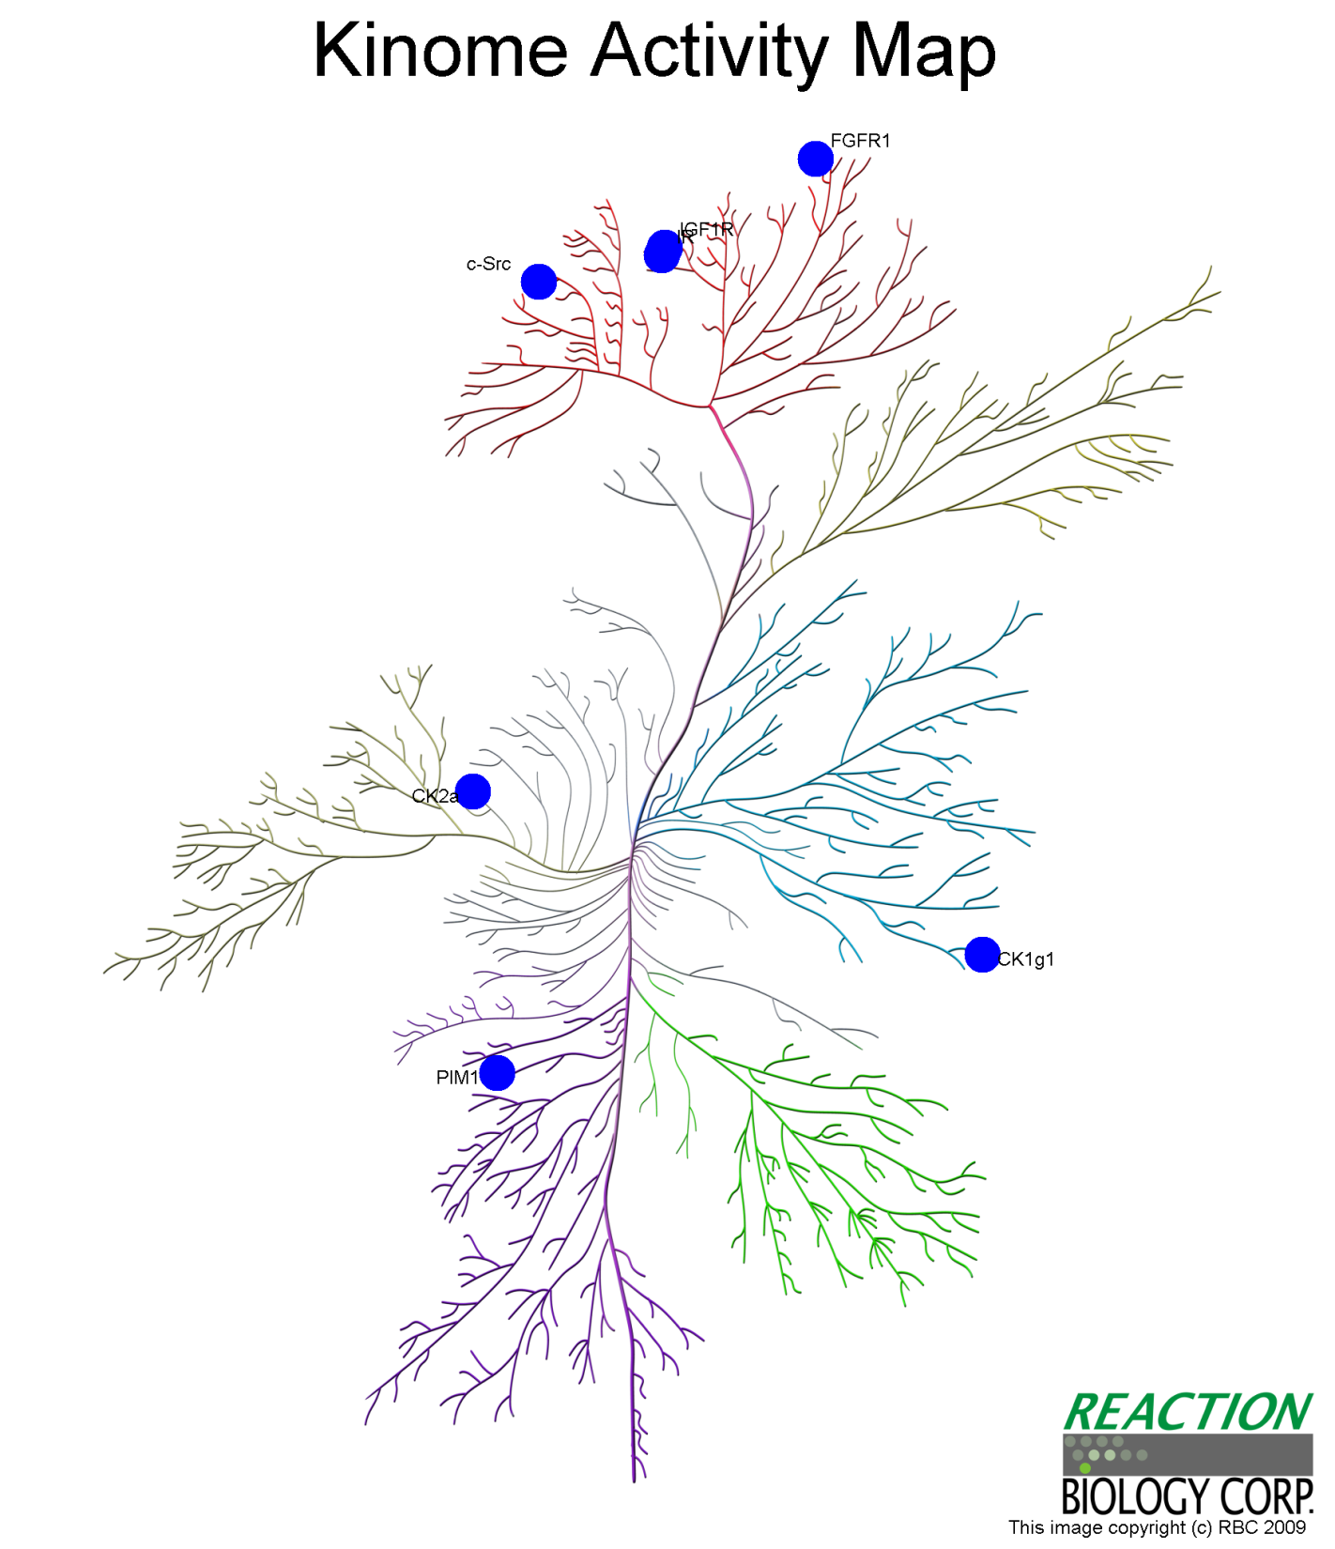
JMY81
TKL
Compound 2D
Compound Name | ZINC49888963
Target number (IC₅₀<10 uM) | 7 (22%)
Best target | CSNK2A1
KAR | 0.8%
TK
Other
STE
CMGC
CSNK2A1
(KAR = -0.8%)
CK1
PIM1
(KAR = 10.6%)
CSNK1G1
(KAR = 14%)
CAMK
AGC

Slide 30
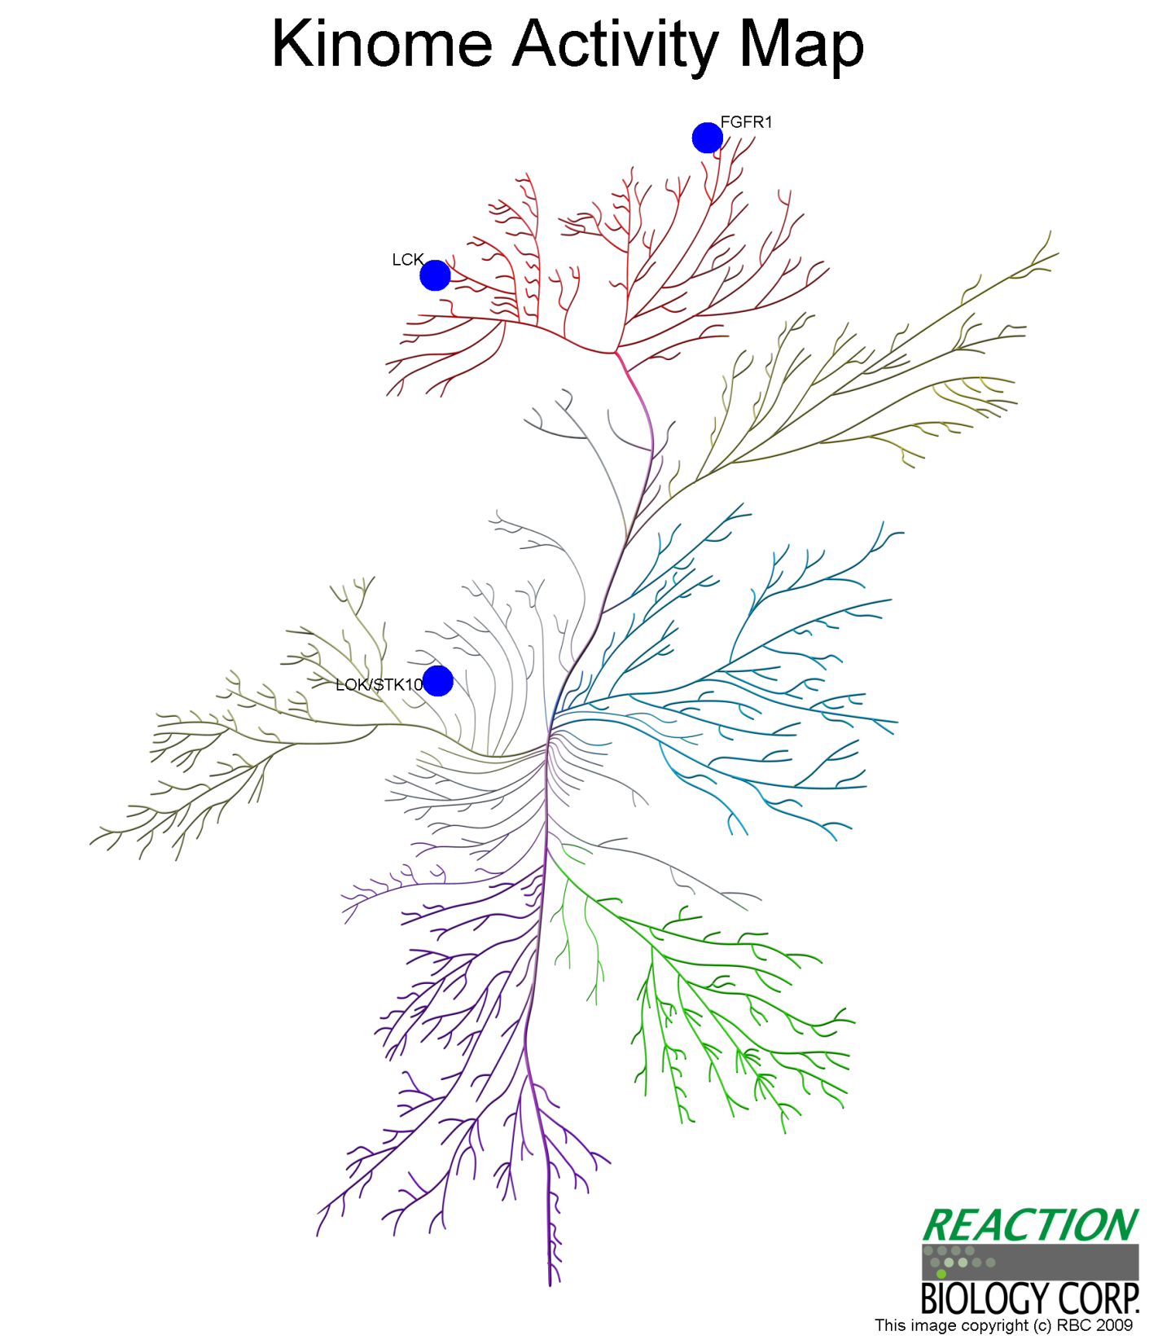
JMY82
FGFR1
(KAR = 1.3%)
LCK
(KAR = 49%)
TKL
Compound 2D
Compound Name | ZINC01546258
Target number (IC₅₀<10 uM) | 3 (9%)
Best target | FGFR1
KAR | 1.3%
TK
STK10
(KAR = 43.3%)
Other
STE
CMGC
CK1
CAMK
AGC

Slide 31
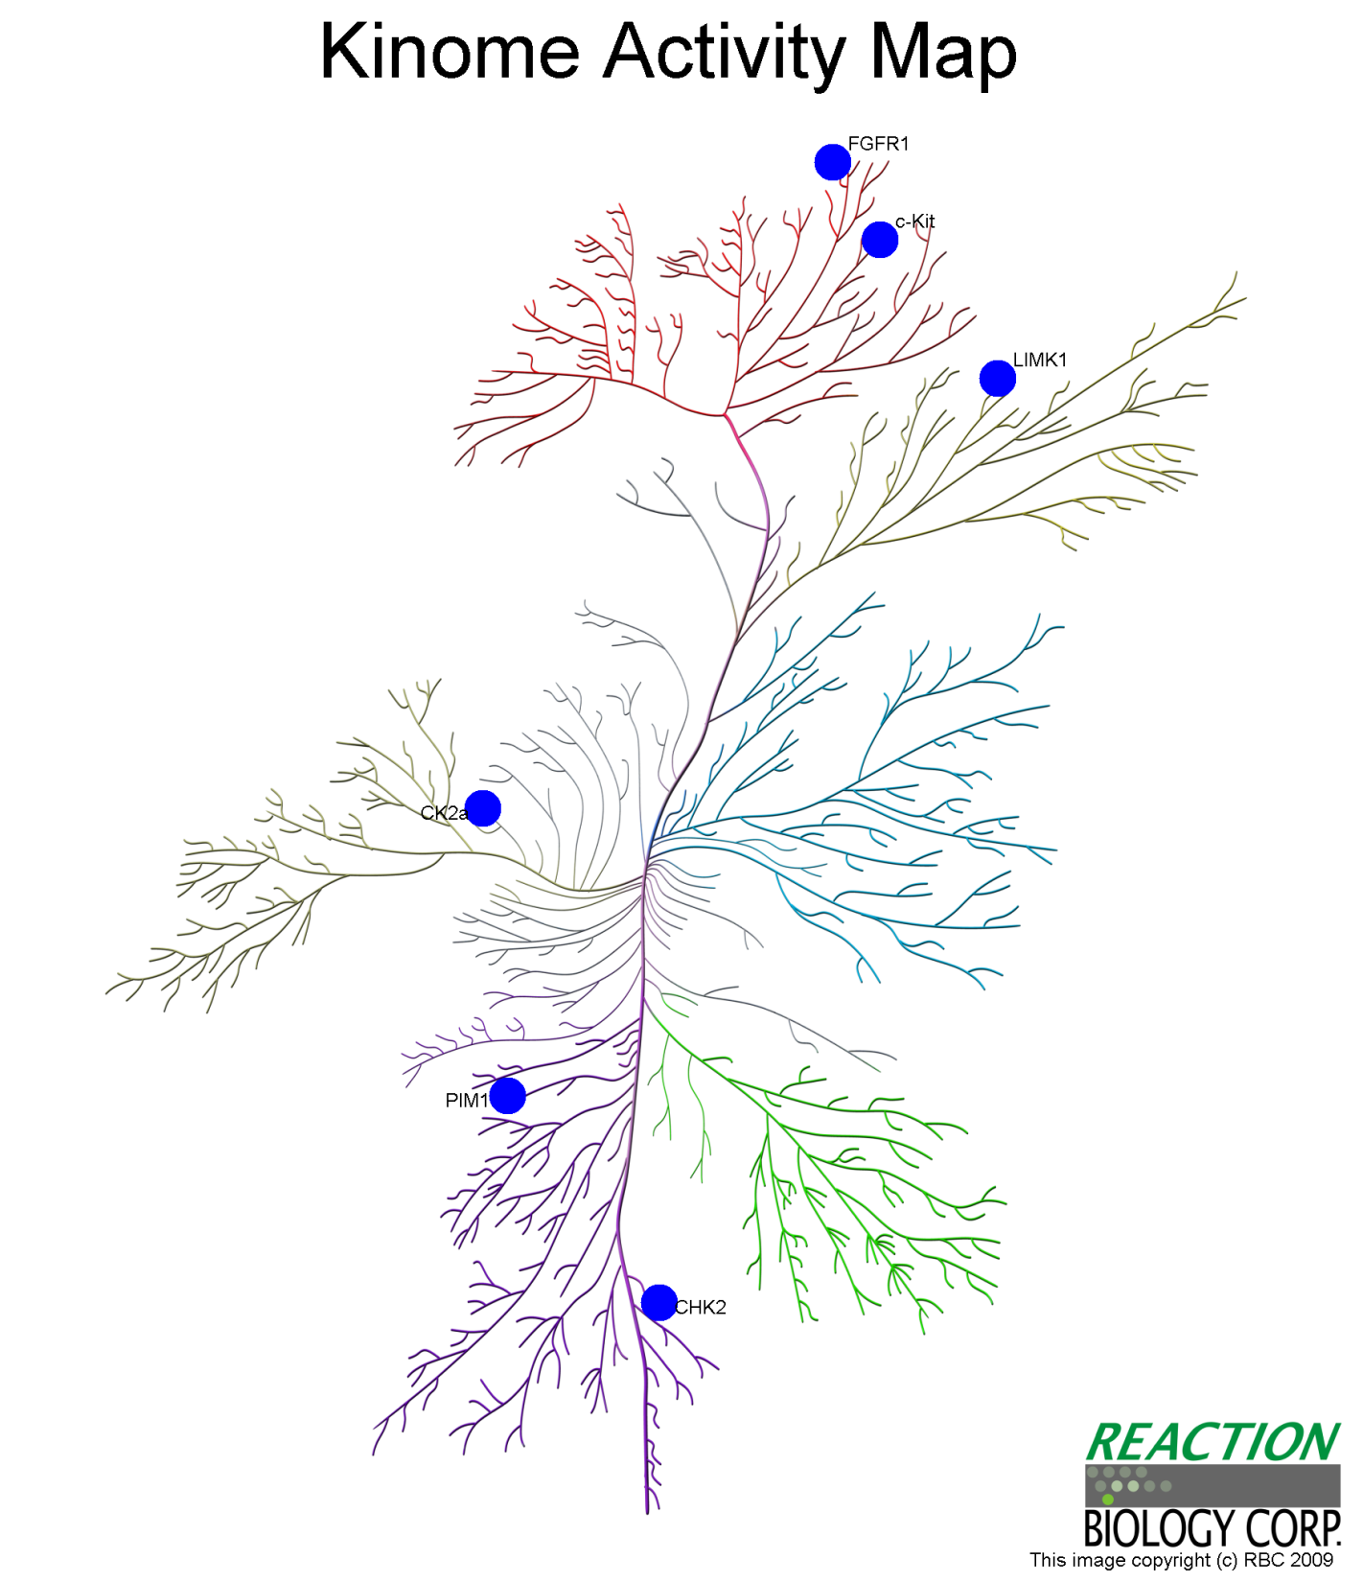
JMY84
LIMK1
(KAR = 27.5%)
Compound 2D
Compound Name | ZINC13424741
Target number (IC₅₀<10 uM) | 6 (19%)
Best target | CSNK2A1
KAR | 7.2%
TK
TKL
Other
CSNK2A1
(KAR = 7.2%)
STE
CMGC
CK1
PIM1
(KAR = 11.4%)
CAMK
AGC

Slide 32
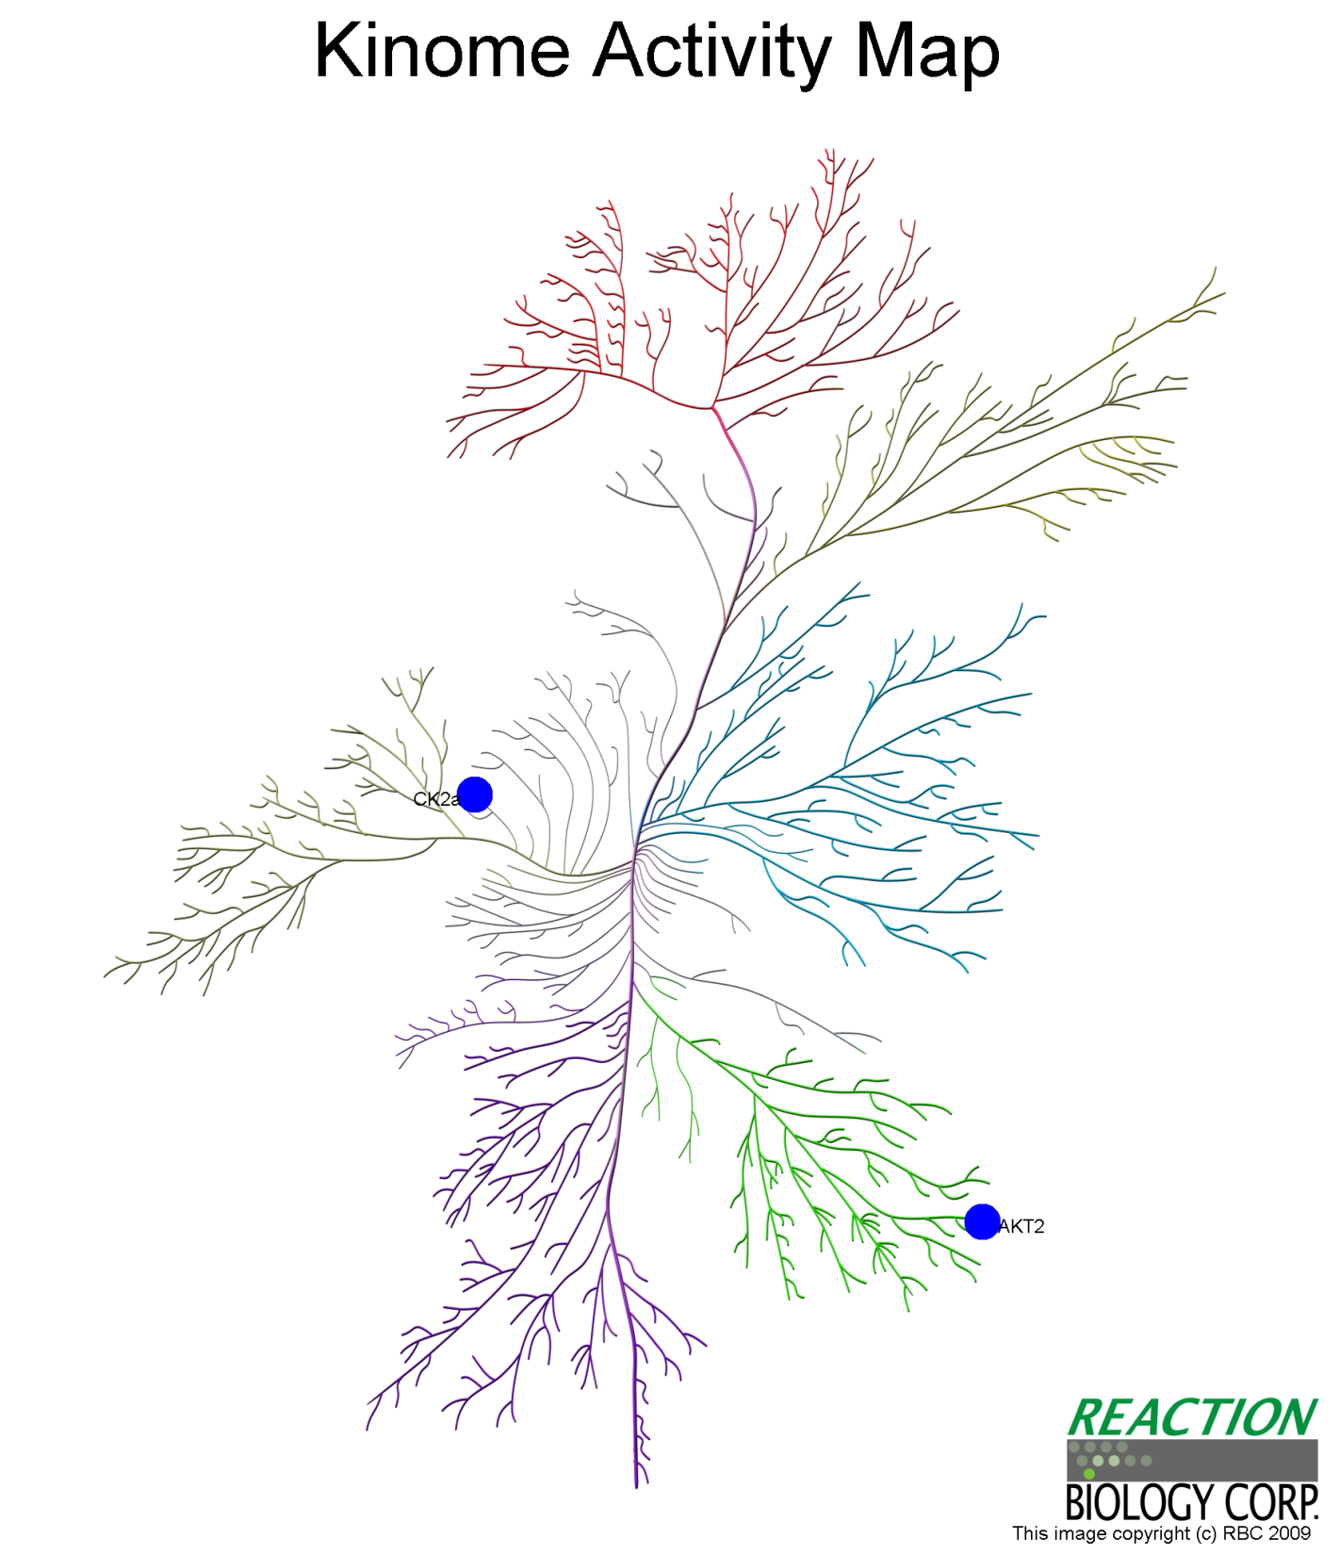
JMY88
TKL
Compound 2D
Compound Name | ZINC01065219
Target number (IC₅₀<10 uM) | 2 (6%)
Best target | AKT2
KAR | 47%
TK
Other
STE
CMGC
CSNK2A1
(KAR = 48.8%)
CK1
CAMK
AGC
AKT2
(KAR = 47%)

Slide 33
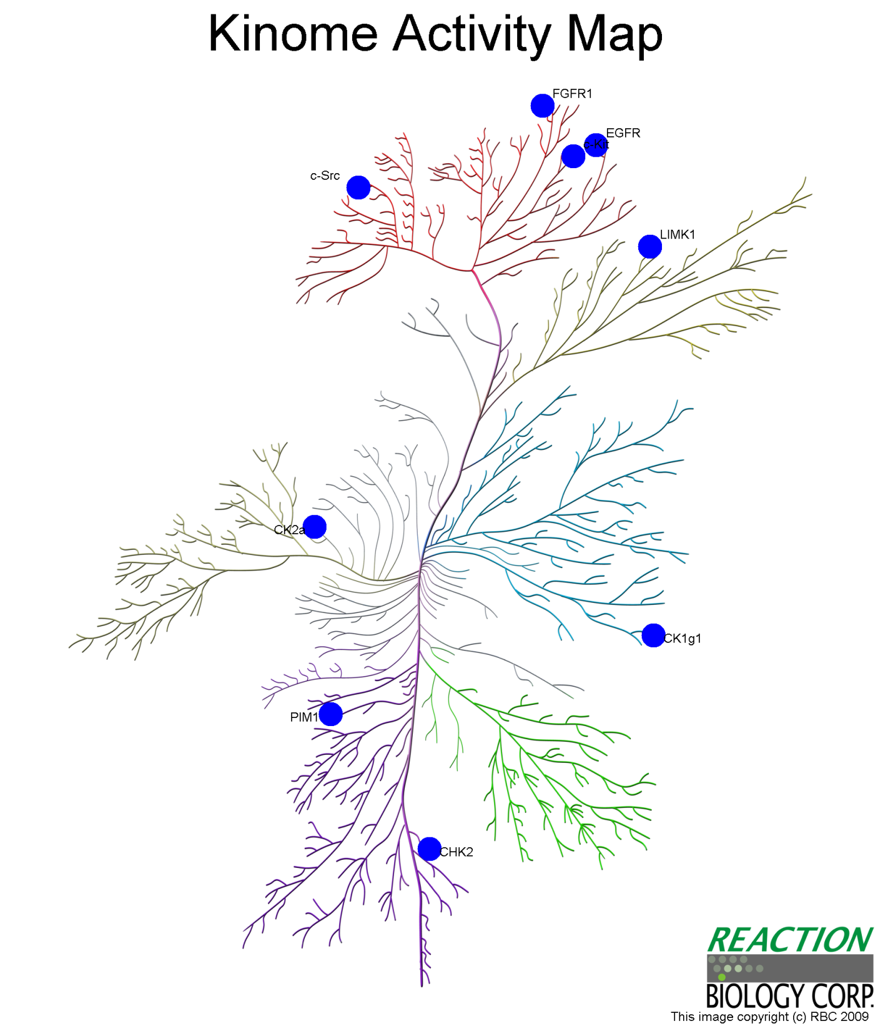
JMY90
KIT
(KAR = 26.6%)
LIMK1
(KAR = 3.6%)
Compound 2D
Compound Name | ZINC12428433
Target number (IC₅₀<10 uM) | 9 (28%)
Best target | LIMK1
KAR | 3.6%
TK
TKL
Other
STE
CMGC
CSNK2A1
(KAR = 19%)
CK1
CAMK
AGC

Slide 34
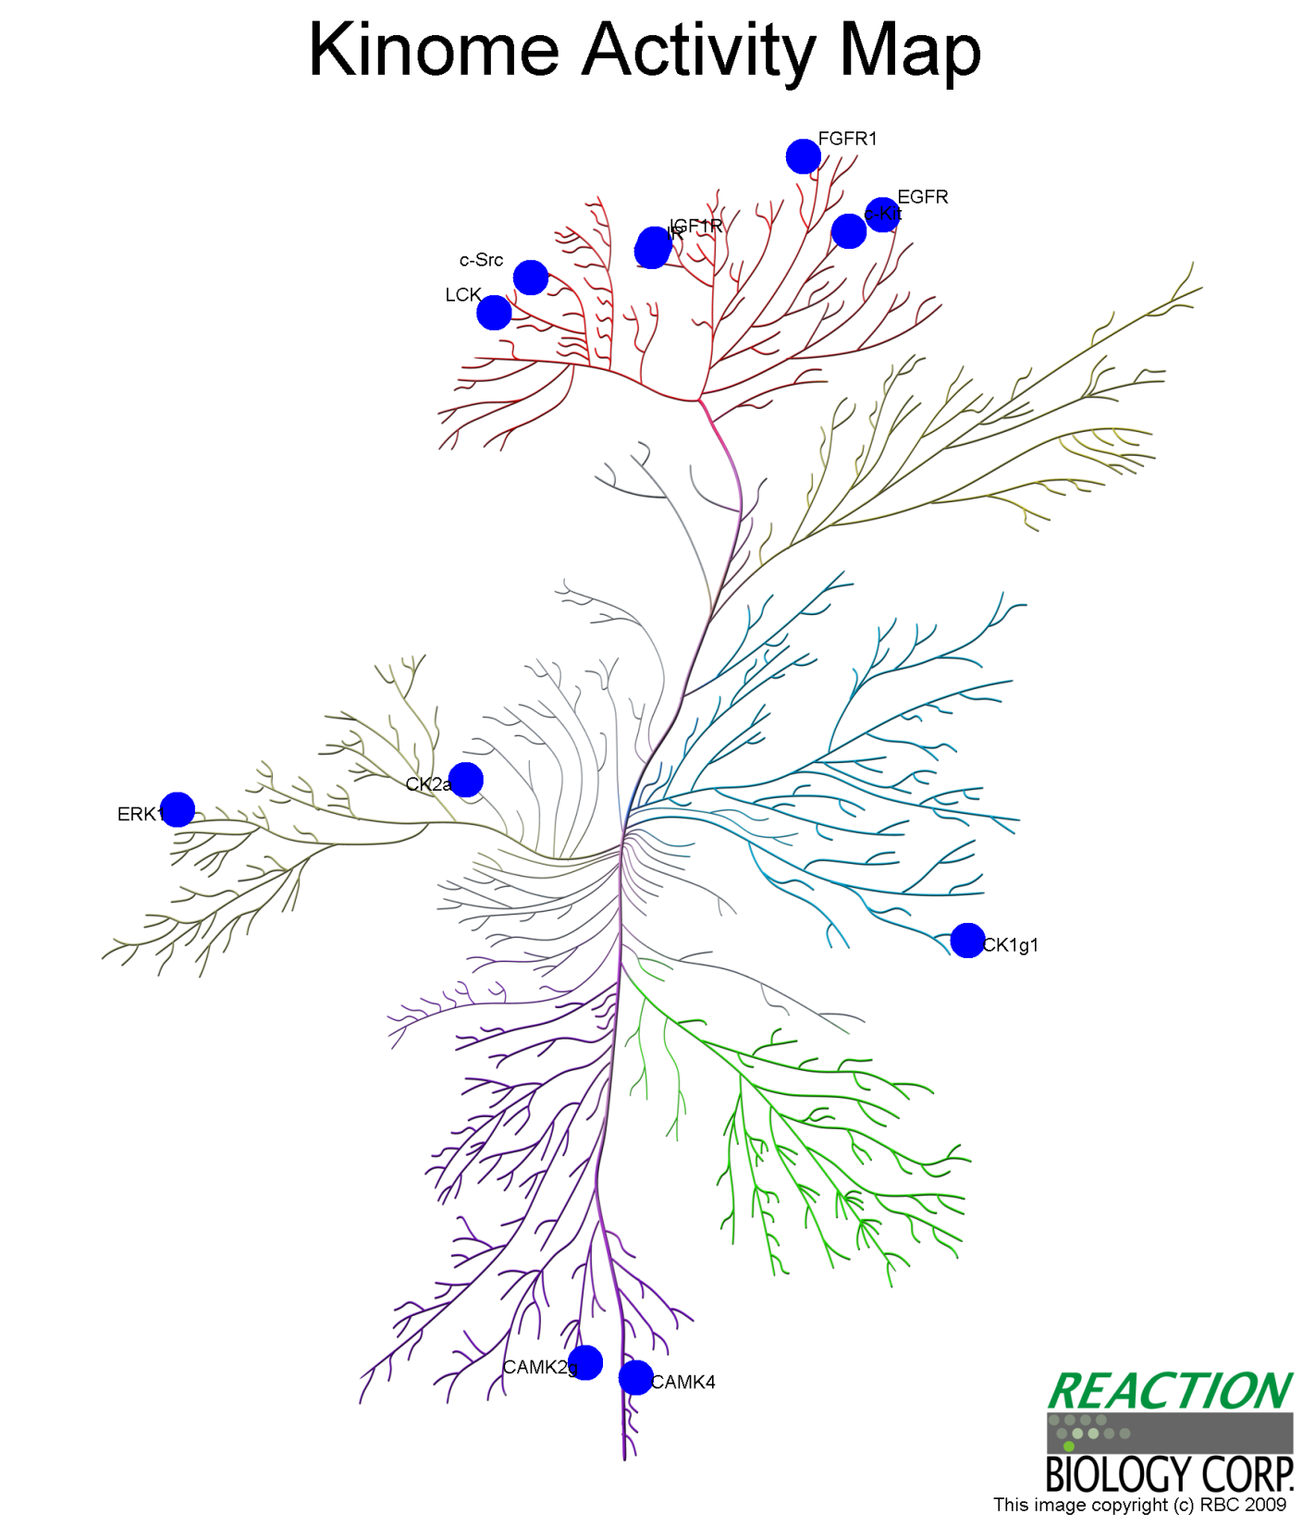
JMY91
FGFR1
(KAR = 9.6%)
TKL
Compound 2D
Compound Name | ZINC13424695
Target number (IC₅₀<10 uM) | 12 (38%)
Best target | CSNK2A1
KAR | 1.1%
TK
Other
STE
CMGC
CSNK2A1
(KAR = 1.1%)
CK1
CSNK1G1
(KAR = 10.4%)
CAMK
AGC

Slide 35
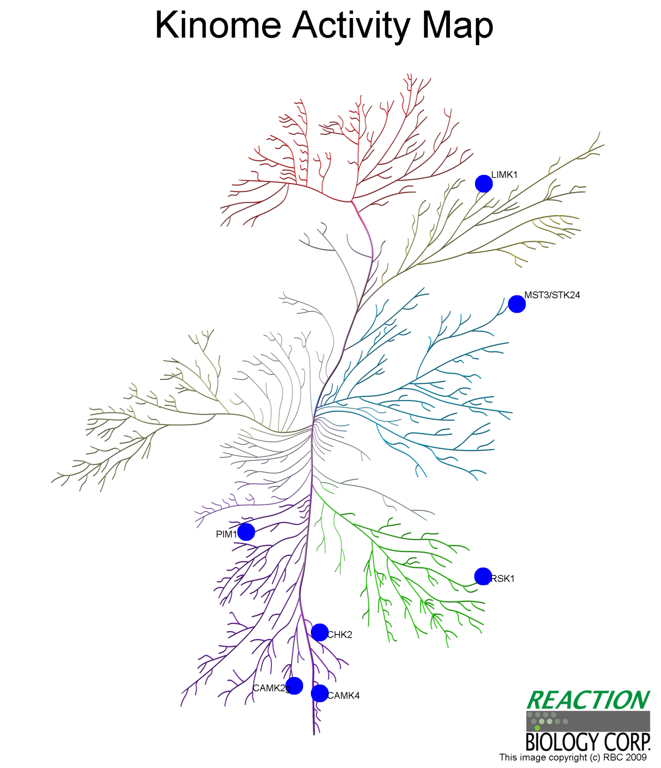
JMY92
LIMK1
(KAR = 5.5%)
Compound 2D
Compound Name | ZINC03874886
Target number (IC₅₀<10 uM) | 7 (22%)
Best target | PIM1
KAR | 3.8%
TK
TKL
Other
STE
CMGC
CK1
PIM1
(KAR = 3.8%)
CAMK
AGC
CAMK4
(KAR = 4.7%)

Slide 36
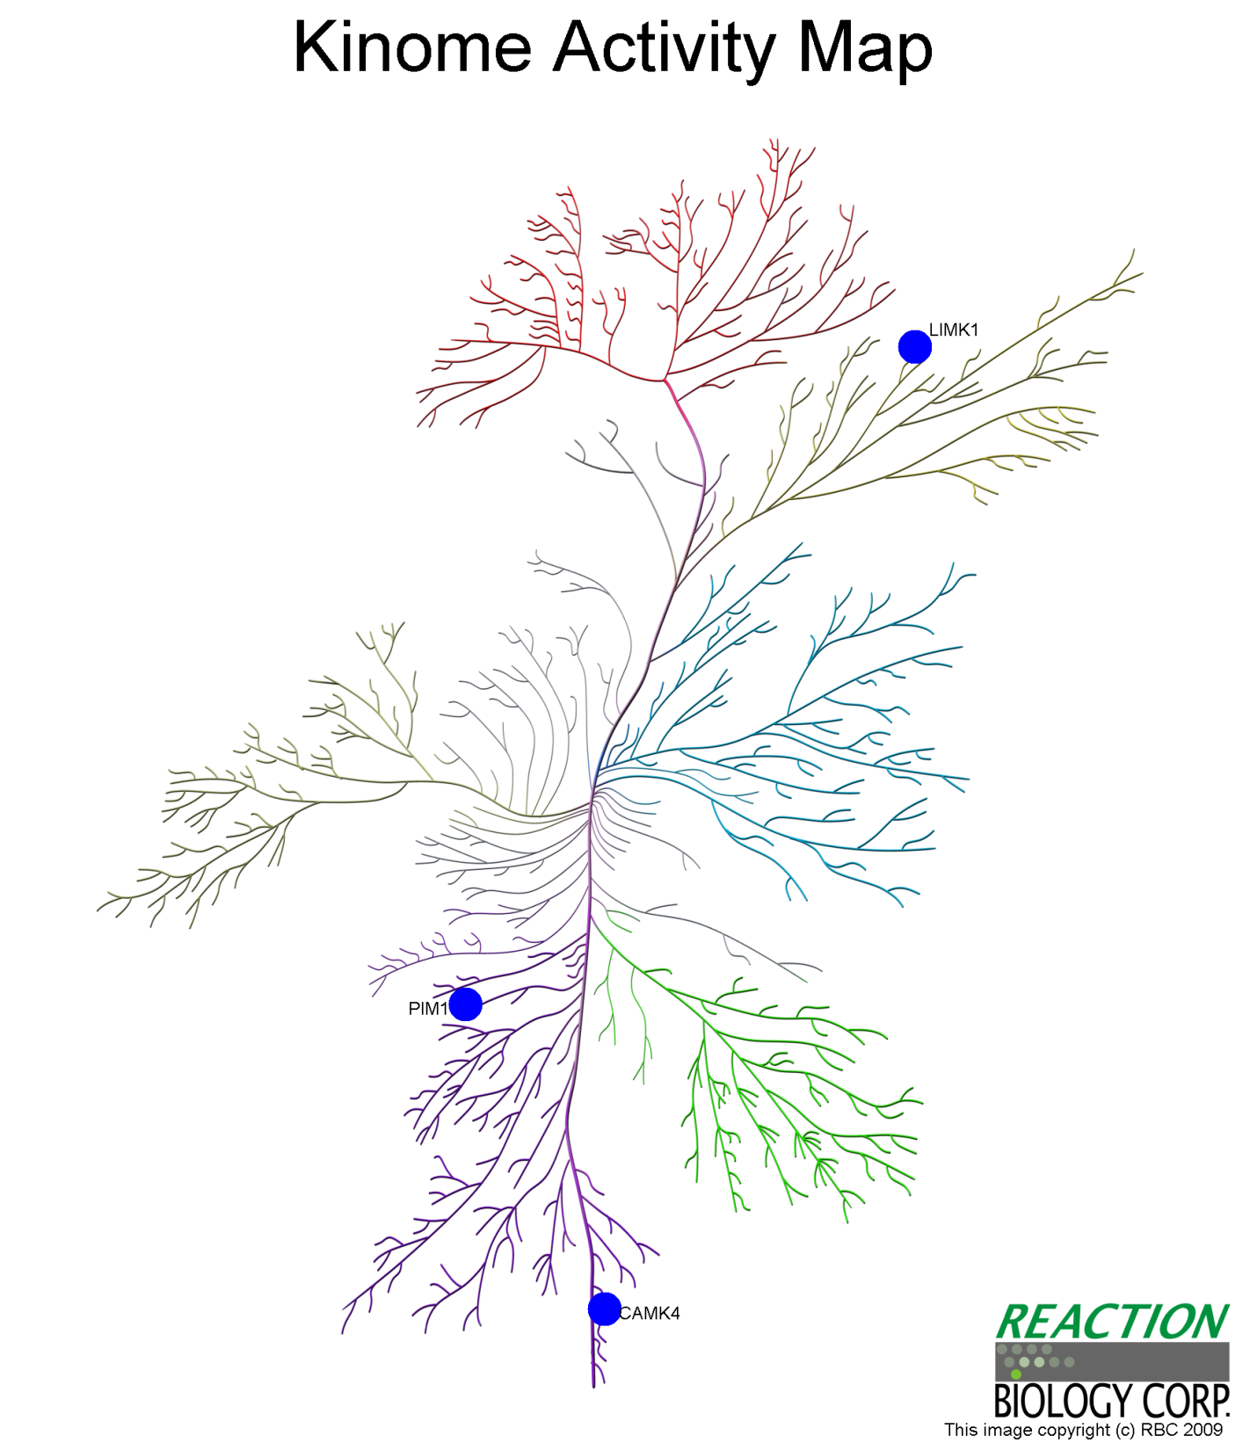
JMY94
LIMK1
(KAR = 47.7%)
Compound 2D
Compound Name | Rosmanol
Target number (IC₅₀<10 uM) | 3 (9%)
Best target | PIM1
KAR | 37.8%
TK
TKL
Other
STE
CMGC
CK1
PIM1
(KAR = 37.8%)
CAMK
AGC
CAMK4
(KAR = 41.7%)

Slide 37

JMY96
TKL
Compound 2D
Compound Name | 6-shogoal
Target number (IC₅₀<10 uM) | 1 (3%)
Best target | CAMK4
KAR | 46.4%
TK
Other
STE
CMGC
CK1
CAMK
AGC
CAMK4
(KAR = 46.4%)

